Slide 1
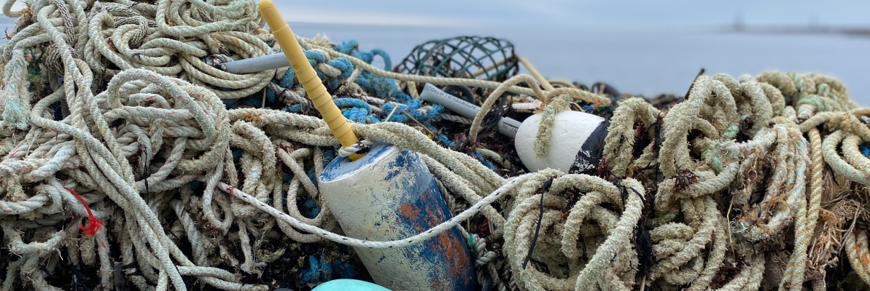
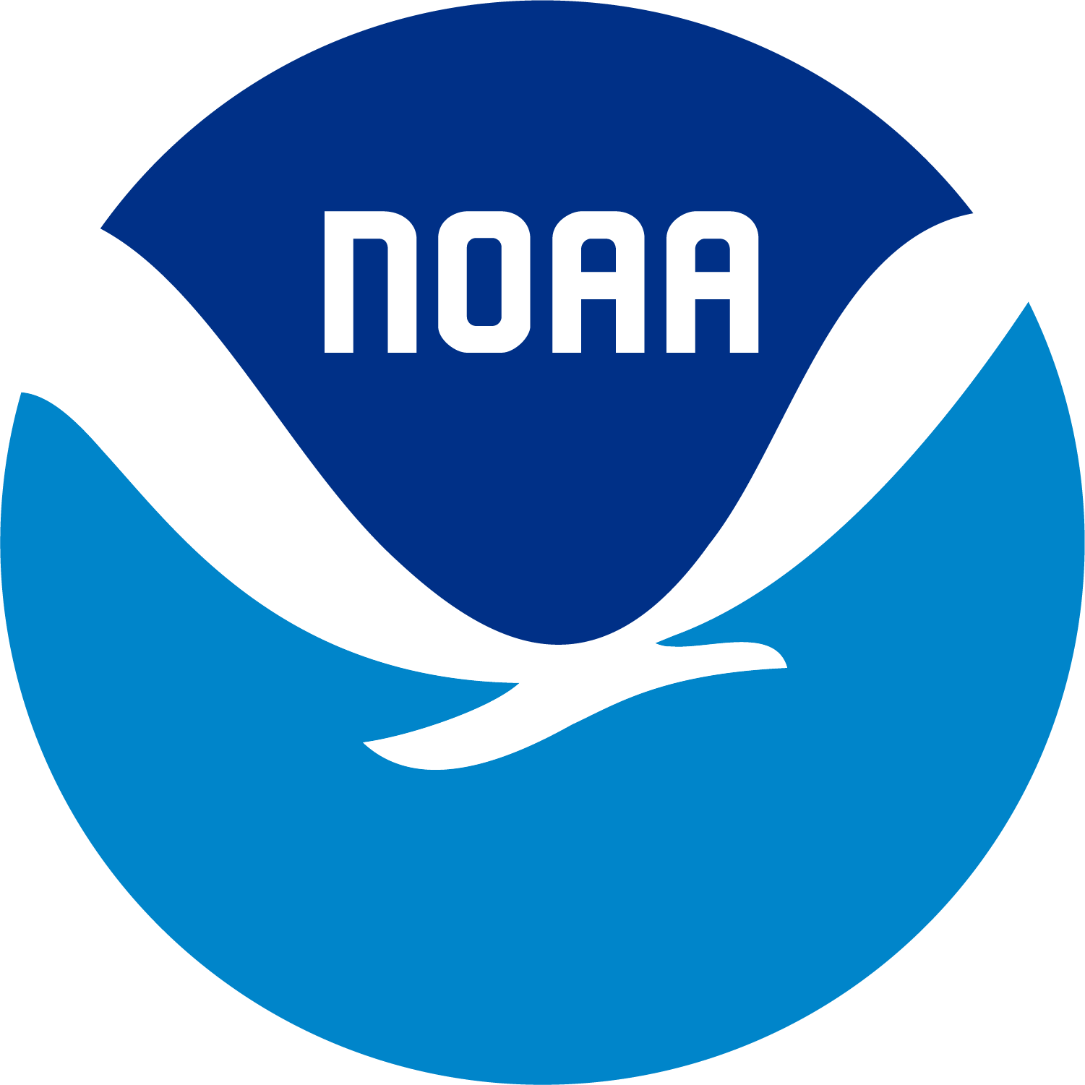
Northeast Marine Debris Webinar
NOAA MARINE DEBRIS PROGRAM
Response to Disaster Debris
Jessi A. James-Barry (she/her)
Gulf of Mexico Regional Coordinator
May 29-30, 2024

Slide 2
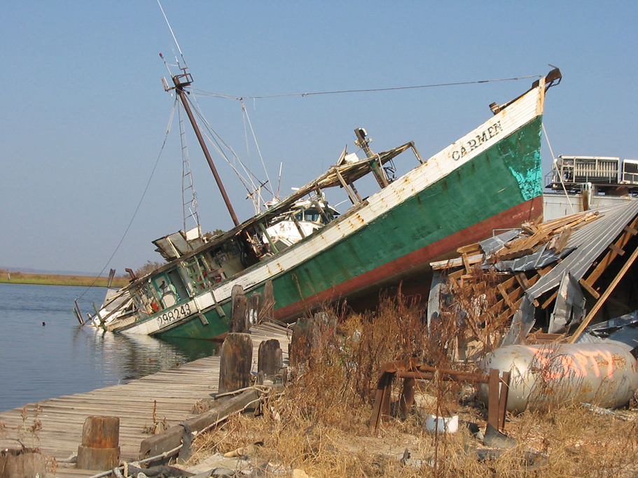
PRESENTATION TAKEAWAYS
Become familiar with the NOAA Marine Debris Program
Learn about funded projects in the Gulf of Mexico Region
Become familiar with the Emergency Response Guide project and tools that can be used for disaster debris
Learn about the Marine Debris Program’s role in disaster response

Slide 3
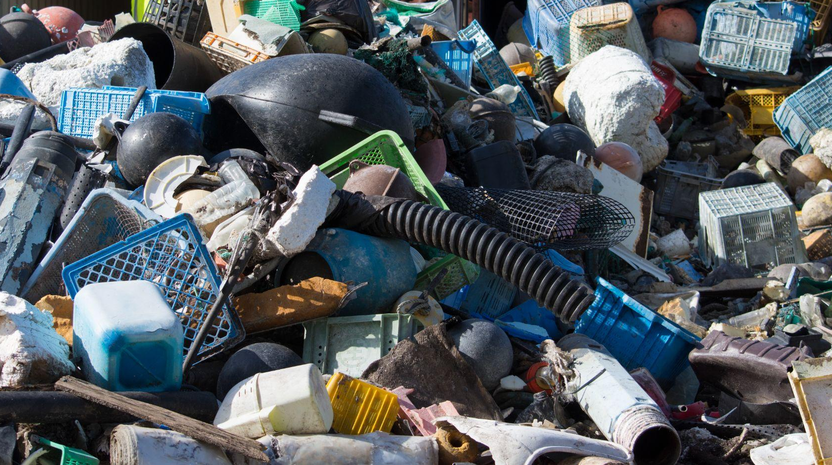
NOAA MARINE DEBRIS PROGRAM
Established by the Marine Debris Act of 2006 as the federal lead for marine debris
Mission: to investigate and prevent the adverse impacts of marine debris
Notes:
MDP is a newer program established in 2006 as the federal lead for marine debris.
We are a small division of ~30 people spread out across the country. Our mission is to prevent the adverse impacts of marine debris. That is a lofty goal given our size, so the way that we drive forward this mission is to align our program into topic areas, or pillars.

Slide 4
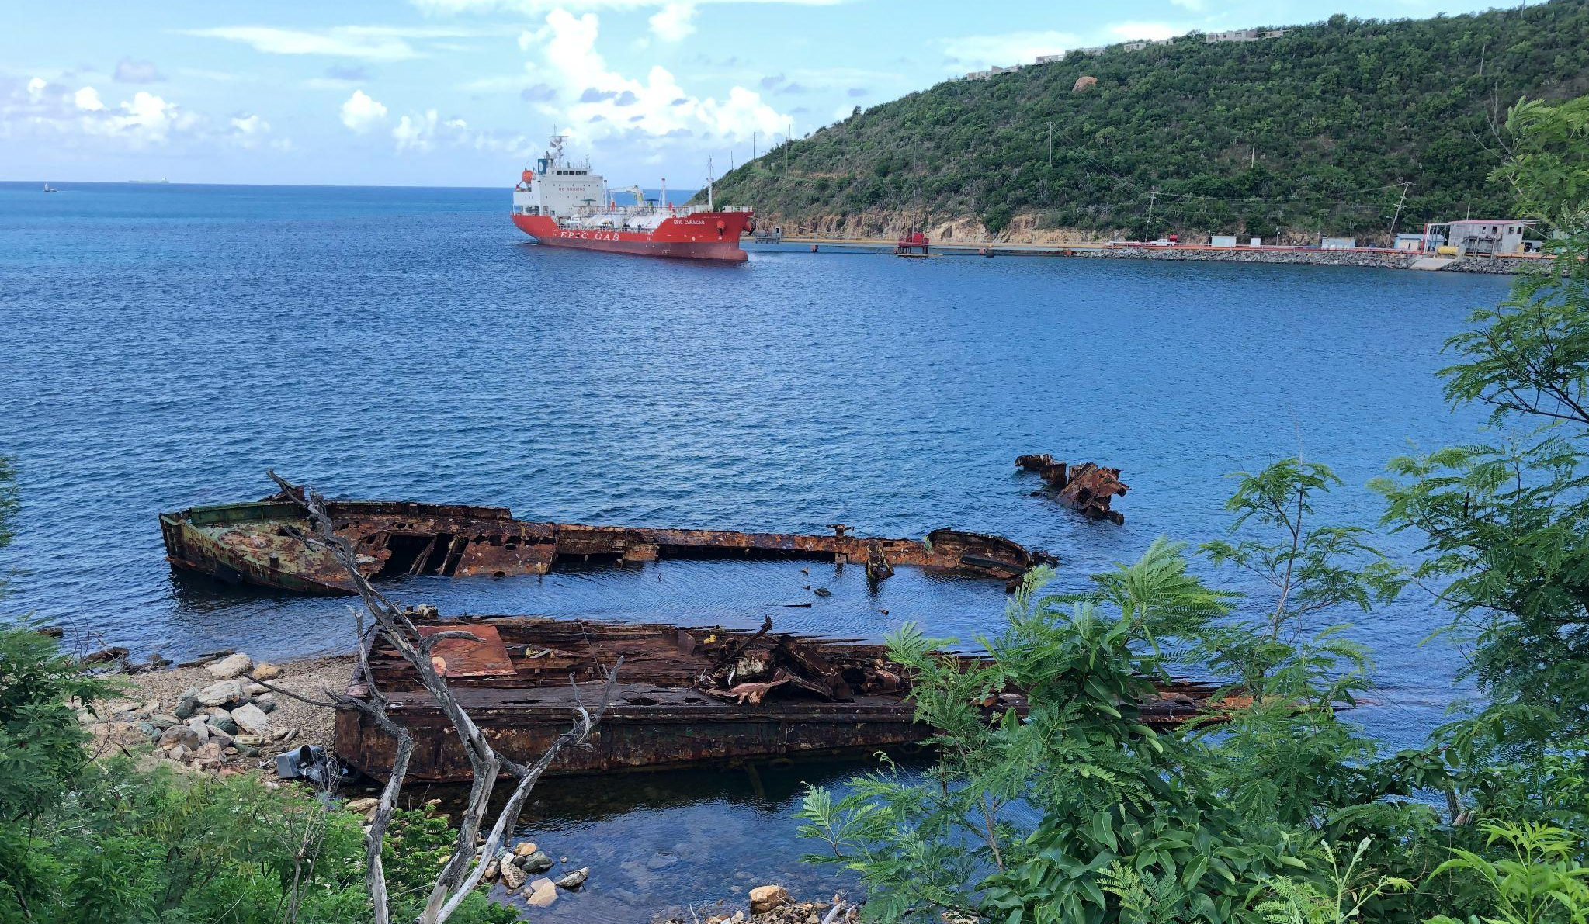
PROGRAM PILLARS
Coordination
Prevention
Removal
Research
Monitoring & Detection
Response
Notes:
We have six core pillars within our program, with response being the one relevant for this talk.
But before we get into response, I’d like to mention that first pillar, coordination!

Slide 5
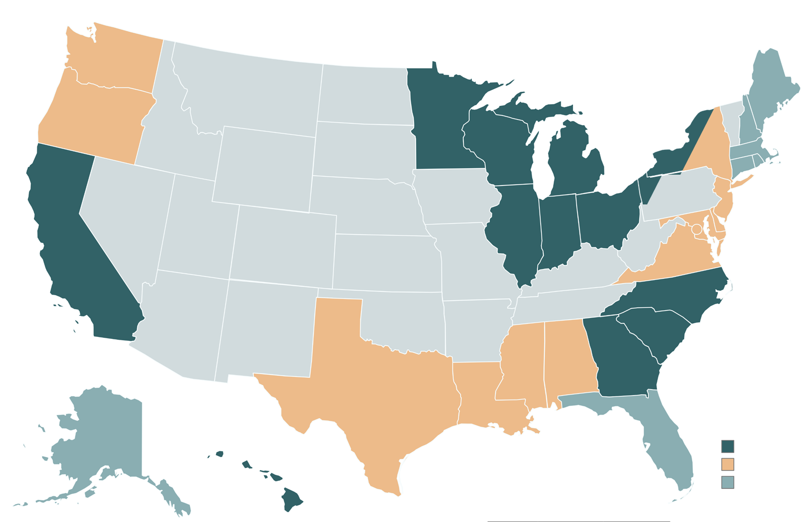

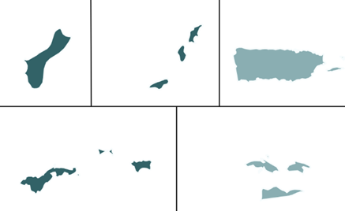
WHERE WE WORK
Notes:
Here are our regions, regional coordinators like me are spread across the US (wherever you see a red pin) and collectively cover all US coastal states, Great Lakes, and US territories.
The 11 Regional Coordinators are responsible for coordinating projects and working with partners across all 6 of our program pillars, including response!

Slide 6
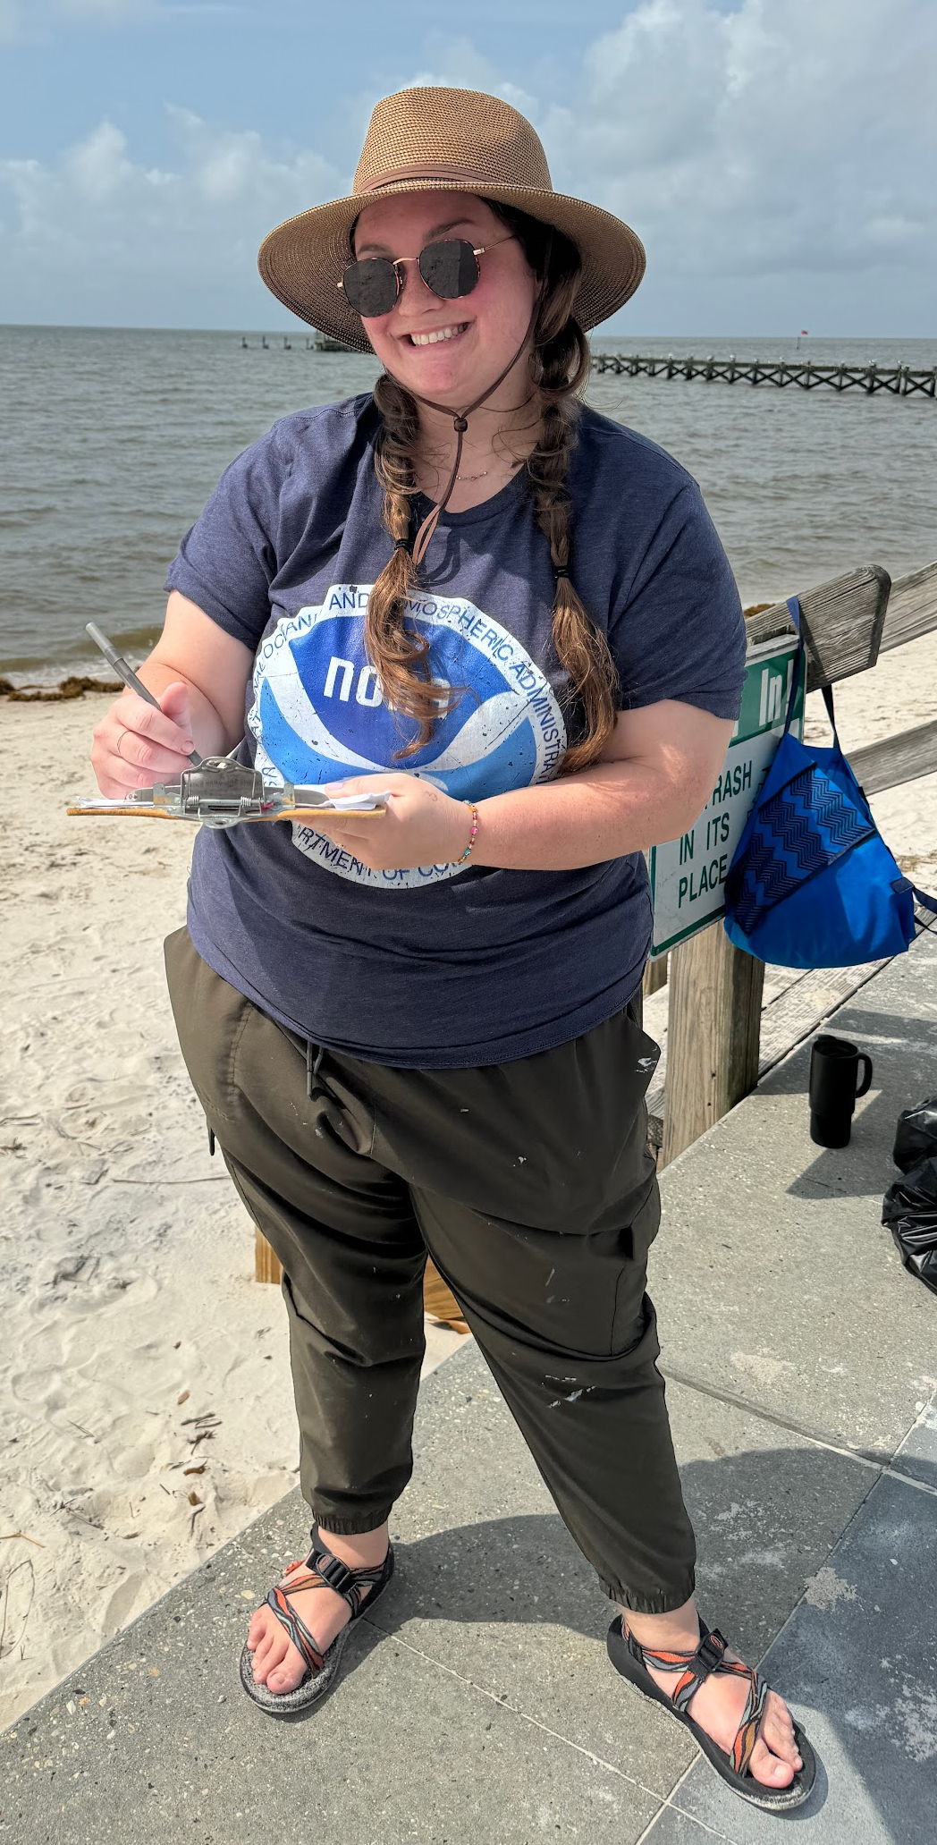
WHERE WE WORK
Jason Rolfe
Response Coordinator
jason.rolfe@noaa.gov
Jessi James-Barry
GoMx Regional Coordinator
jessi.james-barry@noaa.gov
Jessica Conway
Response Specialist
jessica.conway@noaa.gov
Notes:
We have to full time response staff (Jason Rolfe & Jess Conway) but that the ReCos are the main POC in the region and can help connect them to response needs.

Slide 7
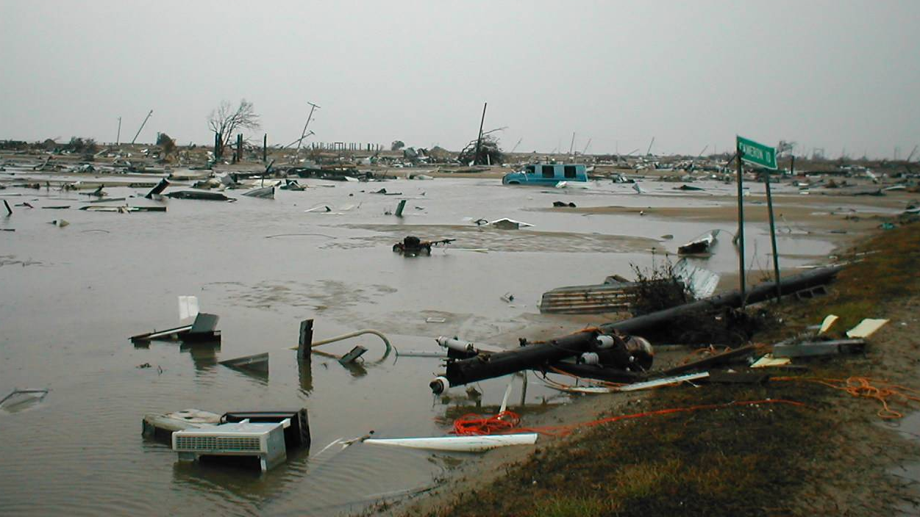
RESPONSE
“Prepare for,
respond to, and recover from the impacts of significant, acute marine debris incidents through coordination and scientific support.”
Notes:
The objective for our response pillar is to help our coastal communities better prepare for, respond to, and recover from marine debris that was generated by a disaster or other point in time event.
Because we are a non-regulatory program, the way we go about this is through providing scientific support, resources, products, and coordination.
Note that acute debris is different than the everyday chronic debris we are targeting in the other 5 pillars of our program.

Slide 8
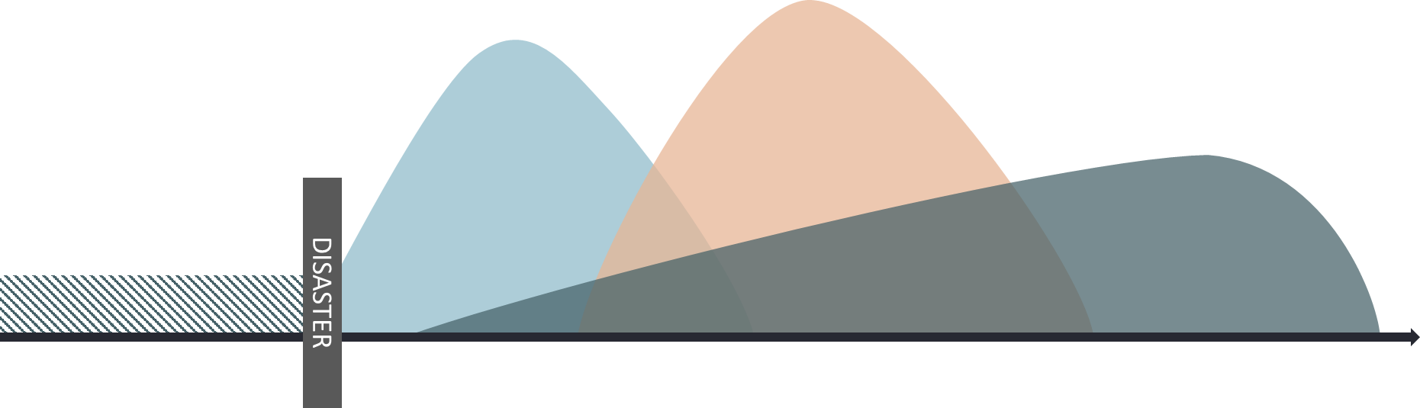
Phases of a Response
PREPAREDNESS
SHORT-TERM
INTERMEDIATE
LONG-TERM
ONGOING
DAYS
WEEKS-MONTHS
MONTHS-YEARS
Source: Adapted from DHS National Disaster Recovery Framework 2016 and City of Seattle 2015
Notes:
This illustration shows the general response timeline after disaster hits. In the short term response after a disaster, there are not many marine debris, actions being taken. Most likely, this will involve things like clearing shipping channels for safe navigation or responding to pollution threats.
So while we use the term “response” very generally, it’s typically not until the longer term recovery phase, in the months or years after a disaster that the capabilities and priorities start to shift toward marine debris.
The marine debris program, however, does work across all phases of a response, and I will touch on all of those, even though our area of expertise is in the preparedness phase.

Slide 9
MDP Response History
2006
2011/12
2014
Today
Marine Debris Program Established
Japanese Tsunami & Hurricane Sandy
Response Guide Project Established
Preparedness, Response, and Recovery Support
Notes:
Because we are a new program, our response capabilities have evolved over the years. Up until 2011 we acted on a case by case basis because we really had no clear mandate on what our role was in response.
But in 2011 and 2012 the Japanese tsunami and hurricane Sandy left unprecedented amounts of marine debris along coastal shoreline and acted as a catalyst for our program to evolve its response posture.
In 2012, congress reauthorized our marine debris act and added specific language on working with local partners to better prepare for marine debris generated after disasters. This let us directly to our largest collaborative project in 2014, which is our marine debris response guide project that I will be spending a few few minutes talking about.
I’ll also note that capabilities have continued to evolve and today we do work across all three of those phases.

Slide 10
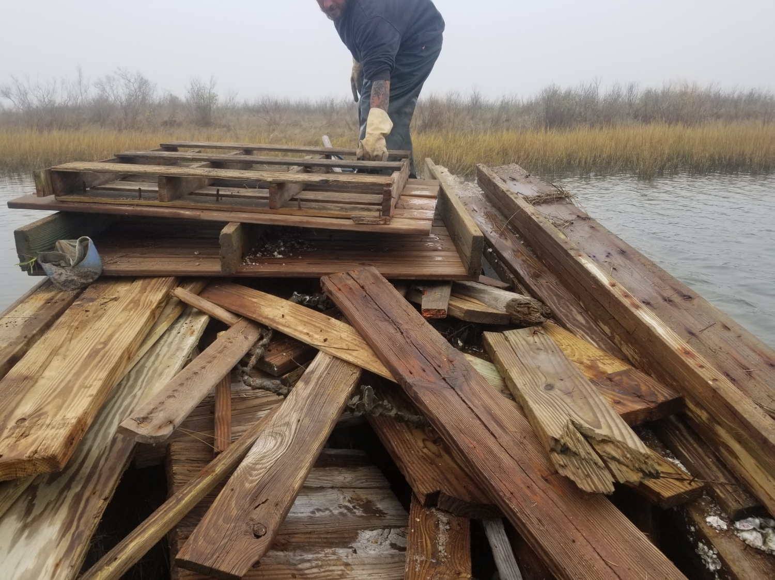
Preparedness Project Goal
Improve preparedness for response to marine debris after disasters in coastal states and U.S. territories
Notes:
The main goal for the preparedness work that we do is to help improve our coastal communities’ preparedness in the response to and recovery from disasters that generate marine debris.

Slide 11
How?
Coordination and relationship building before a disaster
Notes:
The way we go about doing this is mainly through building relationships and coordinating with partners before a disaster so that way communities know where to turn when they have a question and they are familiar with tools and resources they can use prior to a storm.

Slide 12
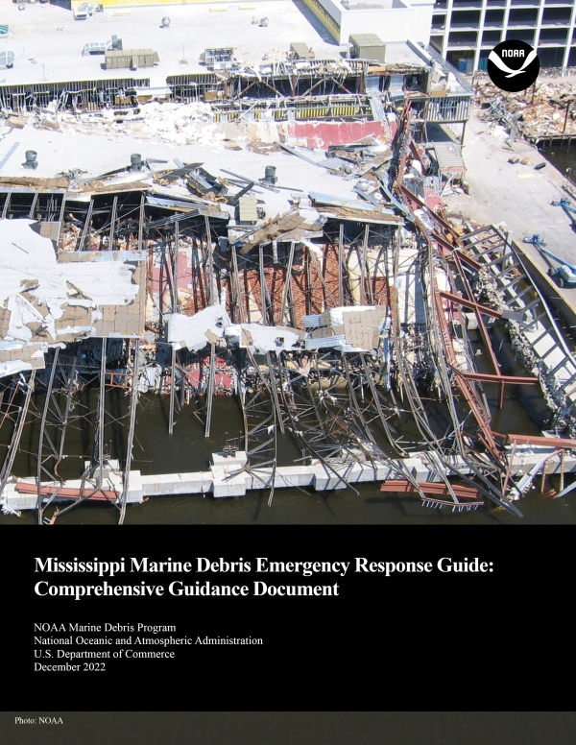
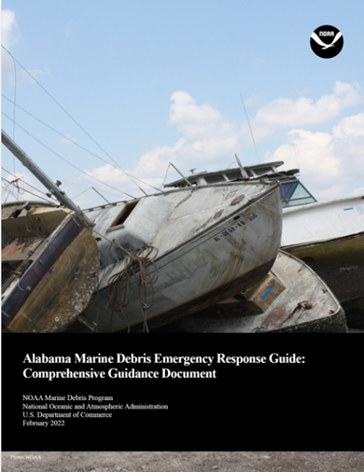
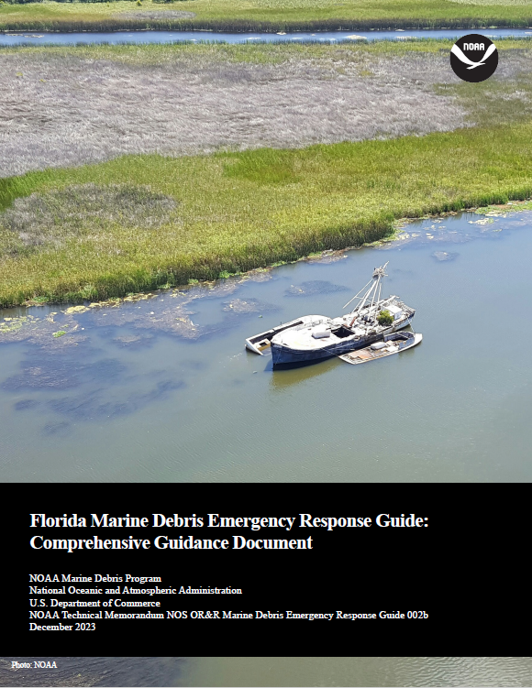
Marine Debris Emergency Response Guides
Notes:
The keystone product that we create through our preparedness work are these marine debris, emergency response guides.
These response guides are a synthesis of existing information about the roles, responsibilities, jurisdictions, and authorities of agencies across all levels of government, including non-governmental organizations.
These products are state and territory specific, and while we are not assigning roles to any agency, we have tried to take all of the pieces of the puzzle across all levels of government and put them together in one quick to reference resource that can be used either for planning purposes or out in the field during a response.
These products are available for download on our Marine Debris Program website.

Slide 13
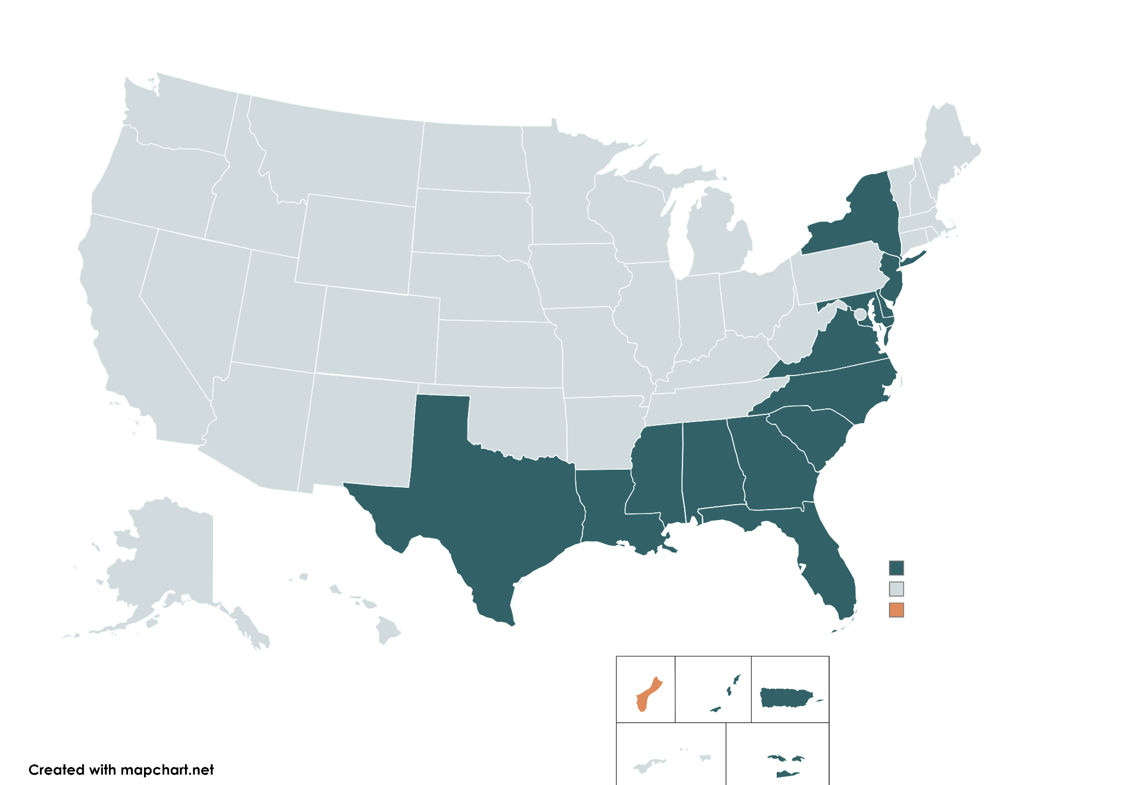
Project Status
17 Published
1 In Development
Notes:
Since the project began in 2014, we have now published 17 state and territory specific response guides in the Gulf of Mexico, East Coast, Pacific islands, and Caribbean territories.
You’ll see that all of the coastal states in RRT Region 4 have response guides available@
We have one guide currently in development, which is the territory of Guam. We hope that that guide will be published late or early Fall of this year.

Slide 14
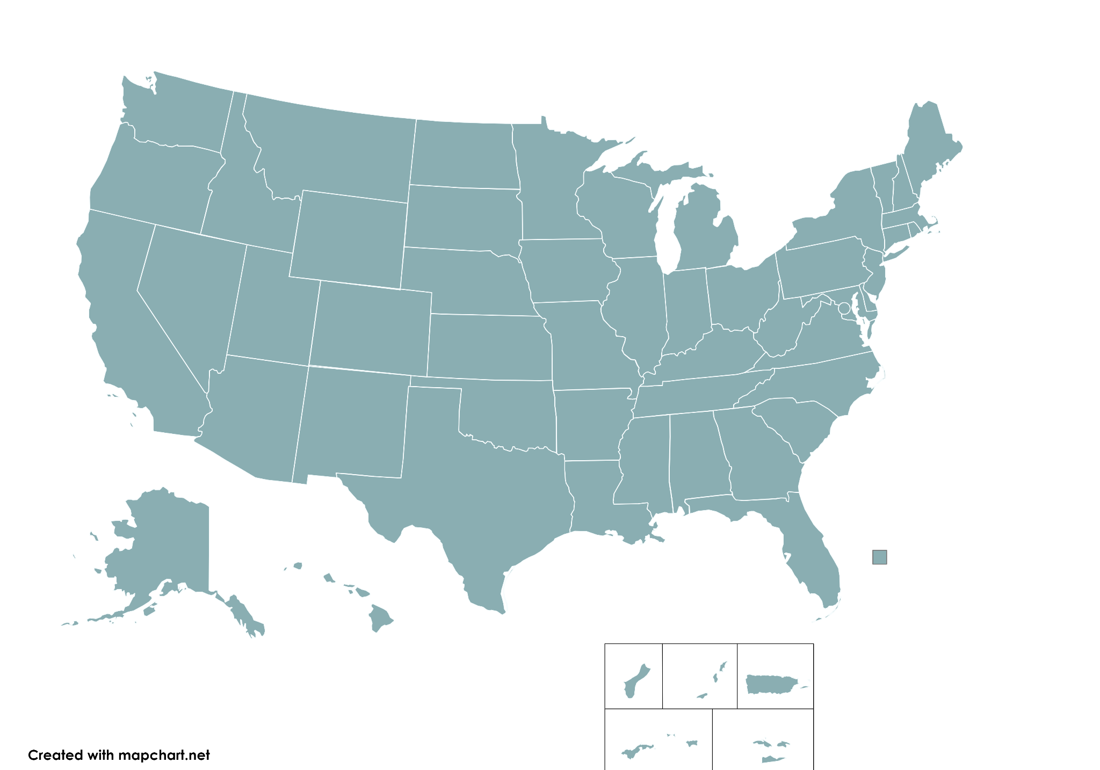
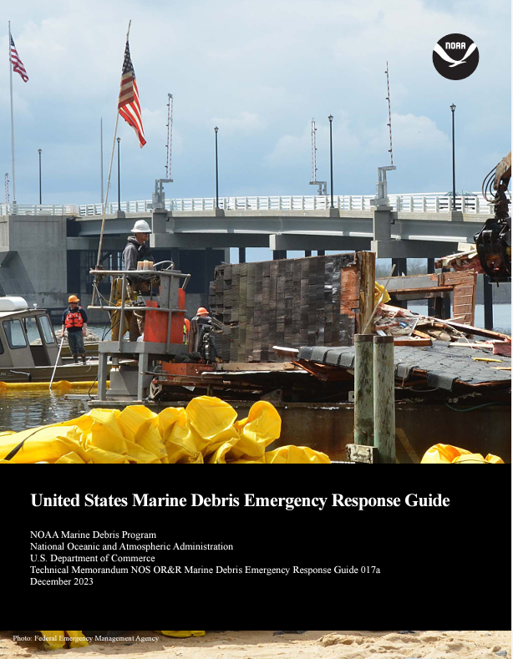
U.S. Marine Debris Emergency Response Guide
Notes:
One thing I want to mention that we are excited to share is that this past December we released the first ever national marine debris emergency response guide
This guide serves as a national resource highlighting the federal response posture and roles, for anyone who may be working regionally without state specific interests, or in a non-Coastal state. This guide also includes local and state planning considerations, for any states that currently don’t have a guide but wish to continue marine debris planning.

Slide 15
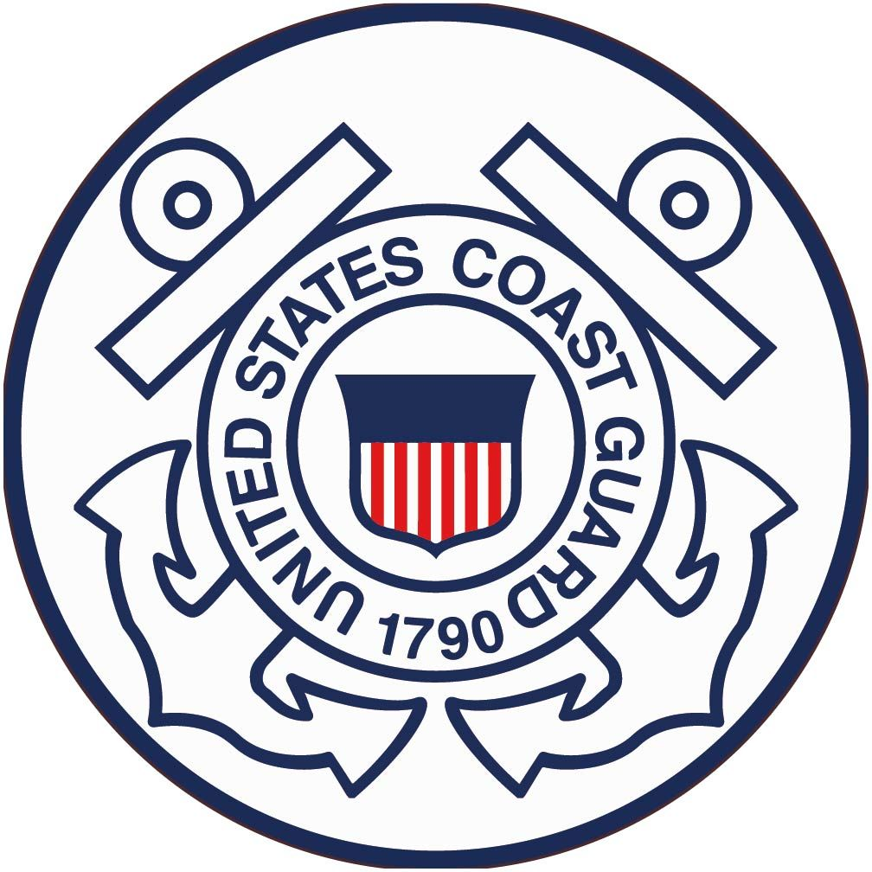
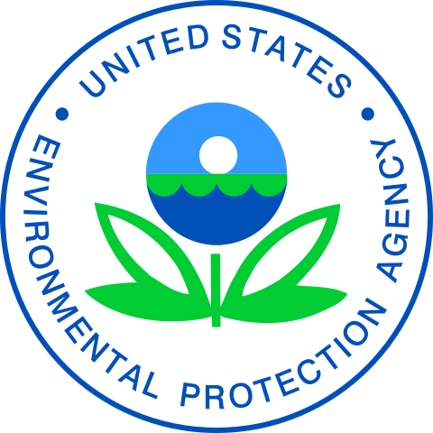
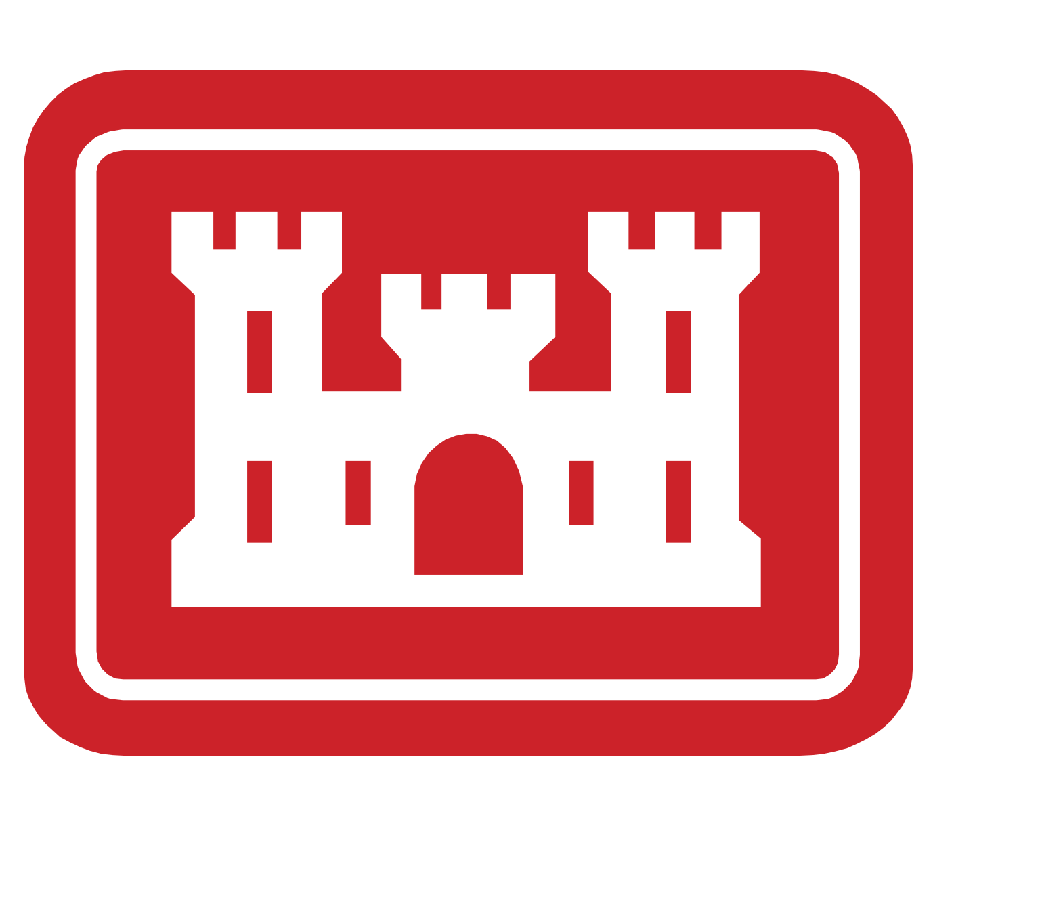
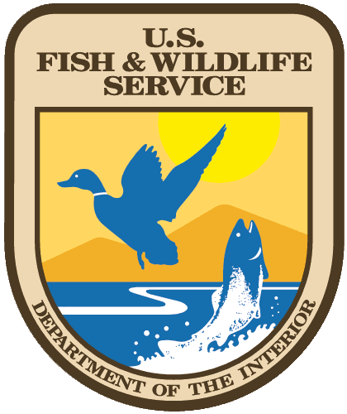

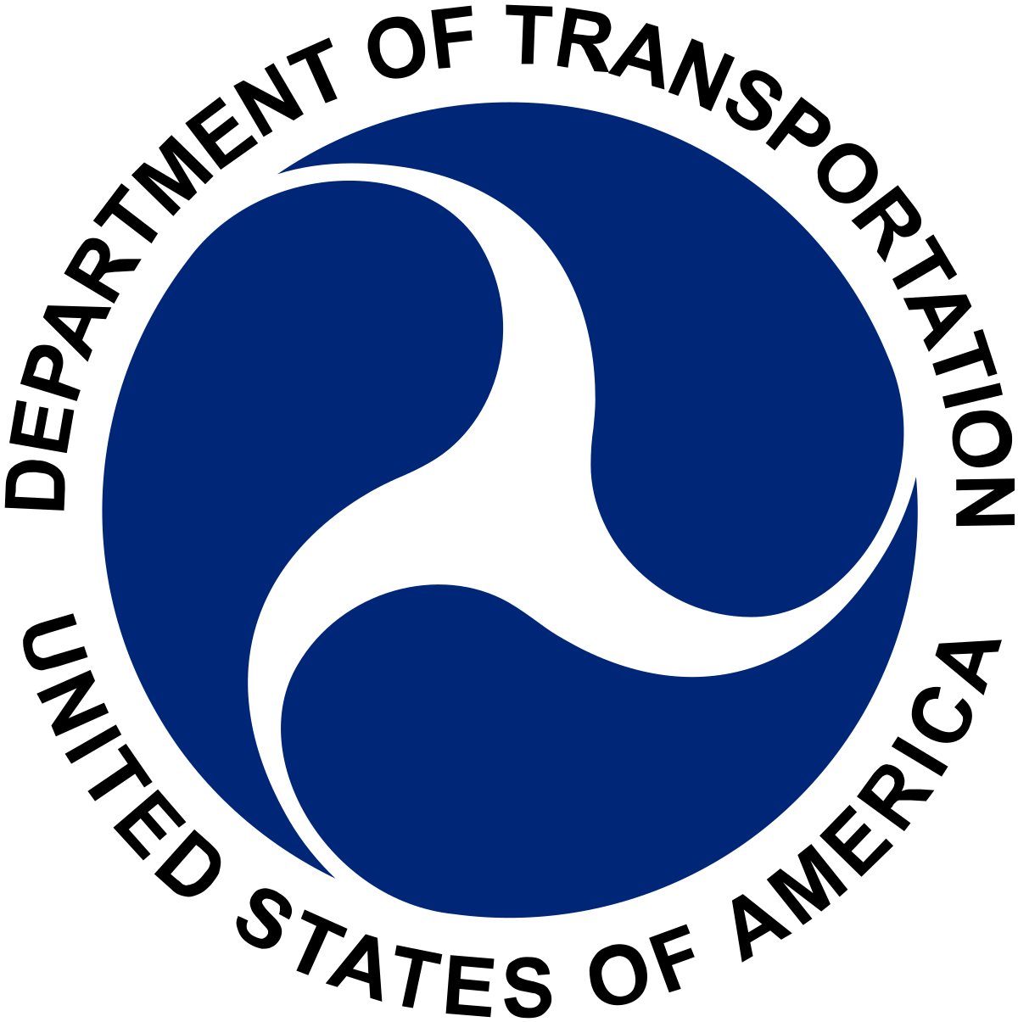
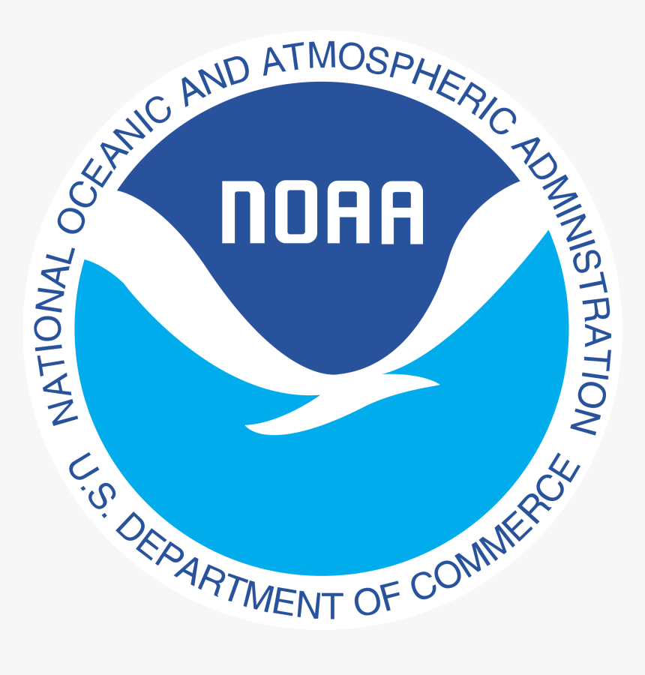

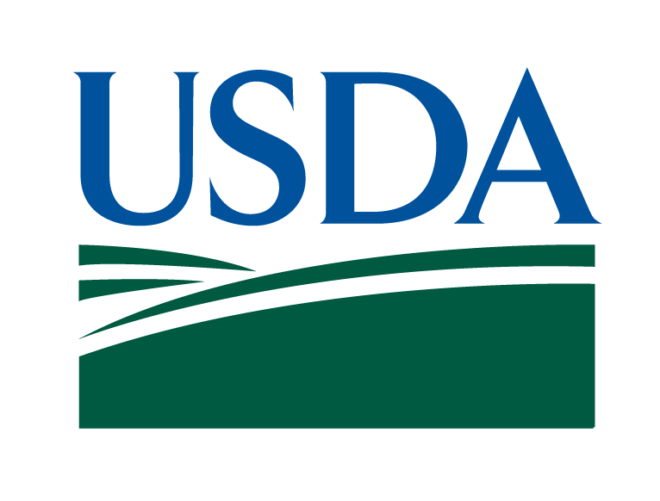
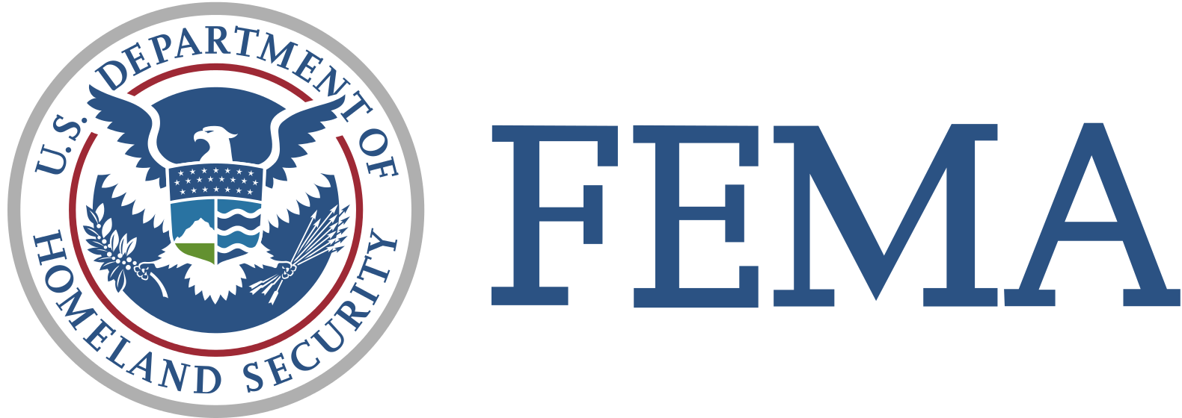
Agency Coordination
Notes:
I’d like to take a moment to acknowledge all of the help and coordination from the federal agencies that were involved in the various guides development. Like I mentioned, This process is a huge collaborative effort, so we do our best to engage with every agency from all levels of government to help produce resources that are beneficial to the state. There are just a few of the agencies that may be represented here today that have been partners on this project.

Slide 16
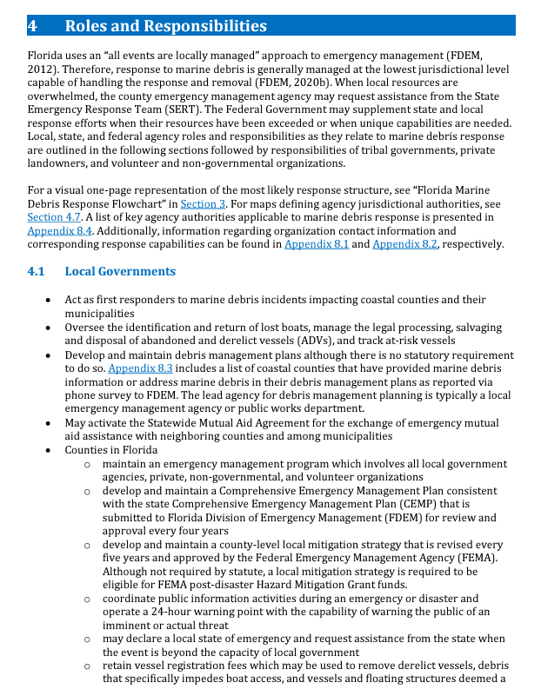
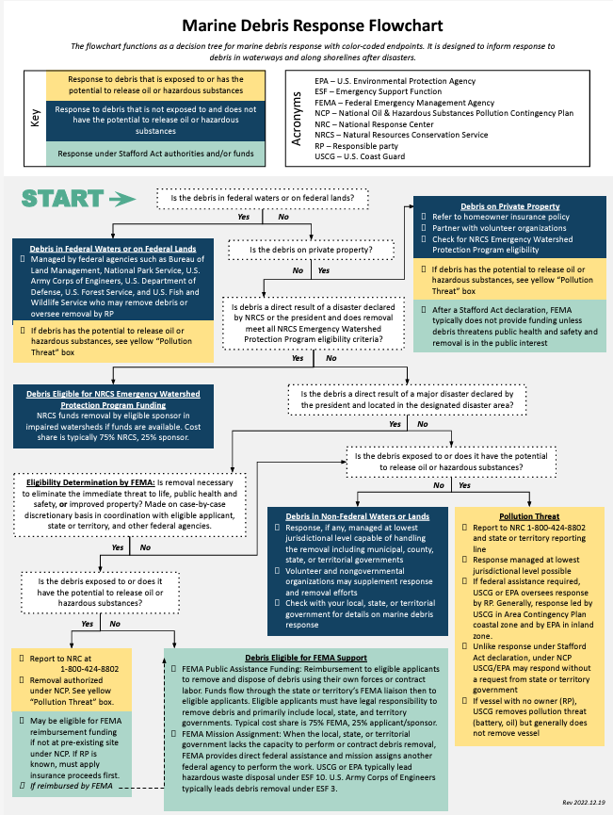
Guide Contents
Introduction
Background Risk
Roles and Responsibilities
Response Map
Compliance Requirements
Challenges and Recommended Actions
Capabilities & Contacts
Notes:
Now I’ll step through some of the key features that you’ll find in each of these guides.
Each states guide includes these main sections.
The bulk of the guide and probably the most important section is this roles and responsibilities section which lays out in text format every agency that might have a role to play and what their responsibilities and authorities are.
We’ve also taken that information and turned it into visual, one page handouts and tools that can be used out in the field or in a command post.

Slide 17
Reponse
Flowchart
Decision tree for marine debris response
Color-coded endpoints
Informs response to debris in waterways and on shorelines
For use in the field, command post, or for planning
Notes:
For example, each guide includes a marine debris response flow chart. The flow chart serves at as a decision-making tree to help you understand who might lead a response, depending on the type of debris and where it’s located.
This image here is from the national guide, and I’ll step through some of its features, as the way to use the flow charts are consistent from state to state.

Slide 18
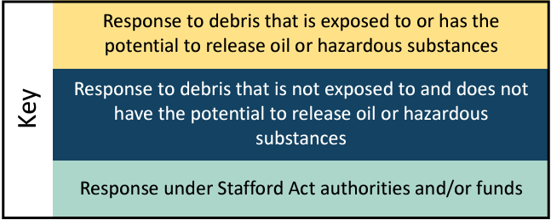
Notes:
Somewhere at the top of every flowchart, you’ll see a color-coded key. Each of these colored boxes correspond to a different type of response. For example, anything in yellow is a response to pollution or potentially hazardous debris.
Any response and point in blue occurs in state or federal waters without pollution response or a Stafford act declaration.
Anything in that teal or green box refers to a response that is occurring under a Stafford act declaration, where FEMA would be the lead Federal agency.

Slide 19
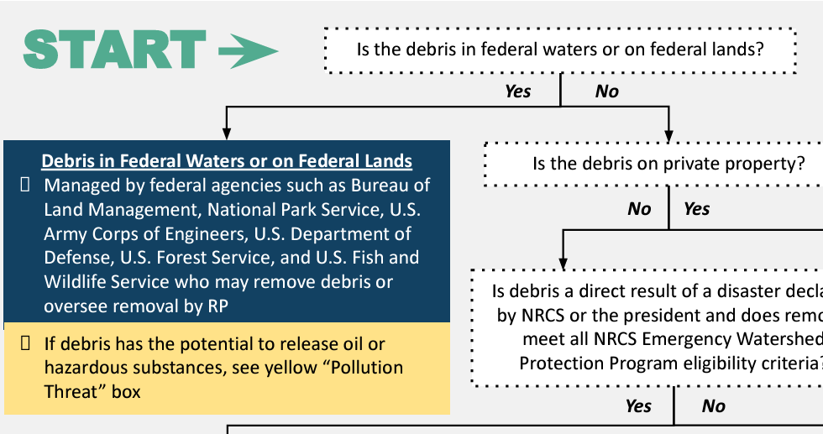
Notes:
To give you an example of how the flow chart would be used and what the questions look like, you would always start with the first question next to the green start arrow.
In this case, it’s asking if debris is in Federal. Waters are on federal lands. Let’s say you answer yes to this question, it will lead you to an end point based on whether or not that response includes debris, potentially oiled or hazardous.
These end boxes are meant to be a jumping off point, a next step, or to give you more information on who you might need to call.

Slide 20
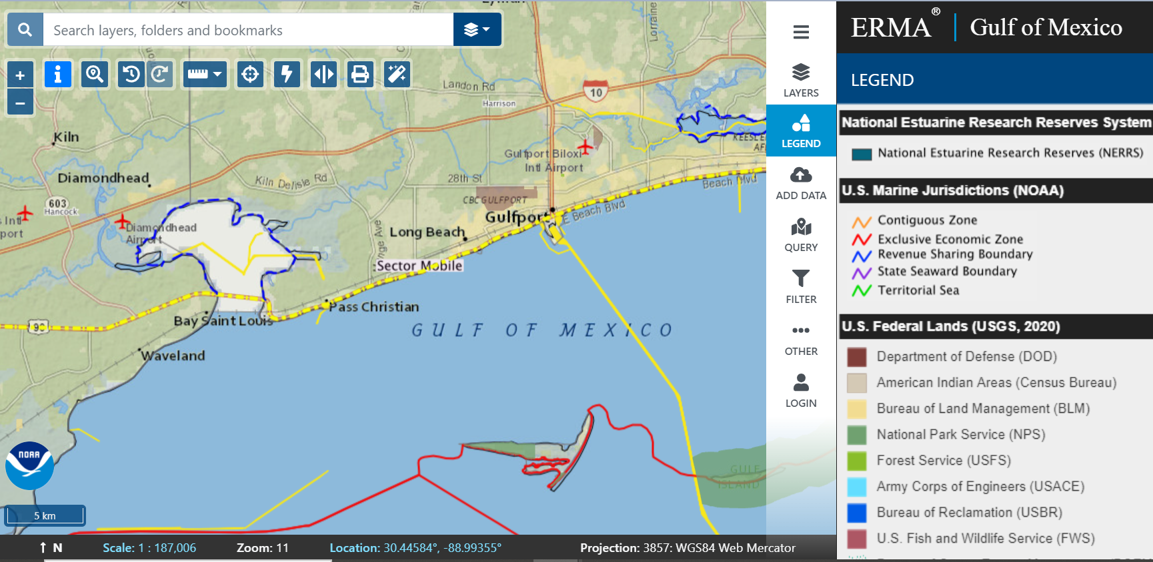
ONLINE ERMA MAPS
Notes:
Another tool that we created for these response guides are jurisdictional maps that are meant to show where different agencies have the authority to respond, and where certain state or federally managed lands and waterways are located.
Each guide includes a static map as well as a online dynamic map that is house in our environmental response management application. No login information is required to access these online maps and they can be a great tool out in the field.

Slide 21

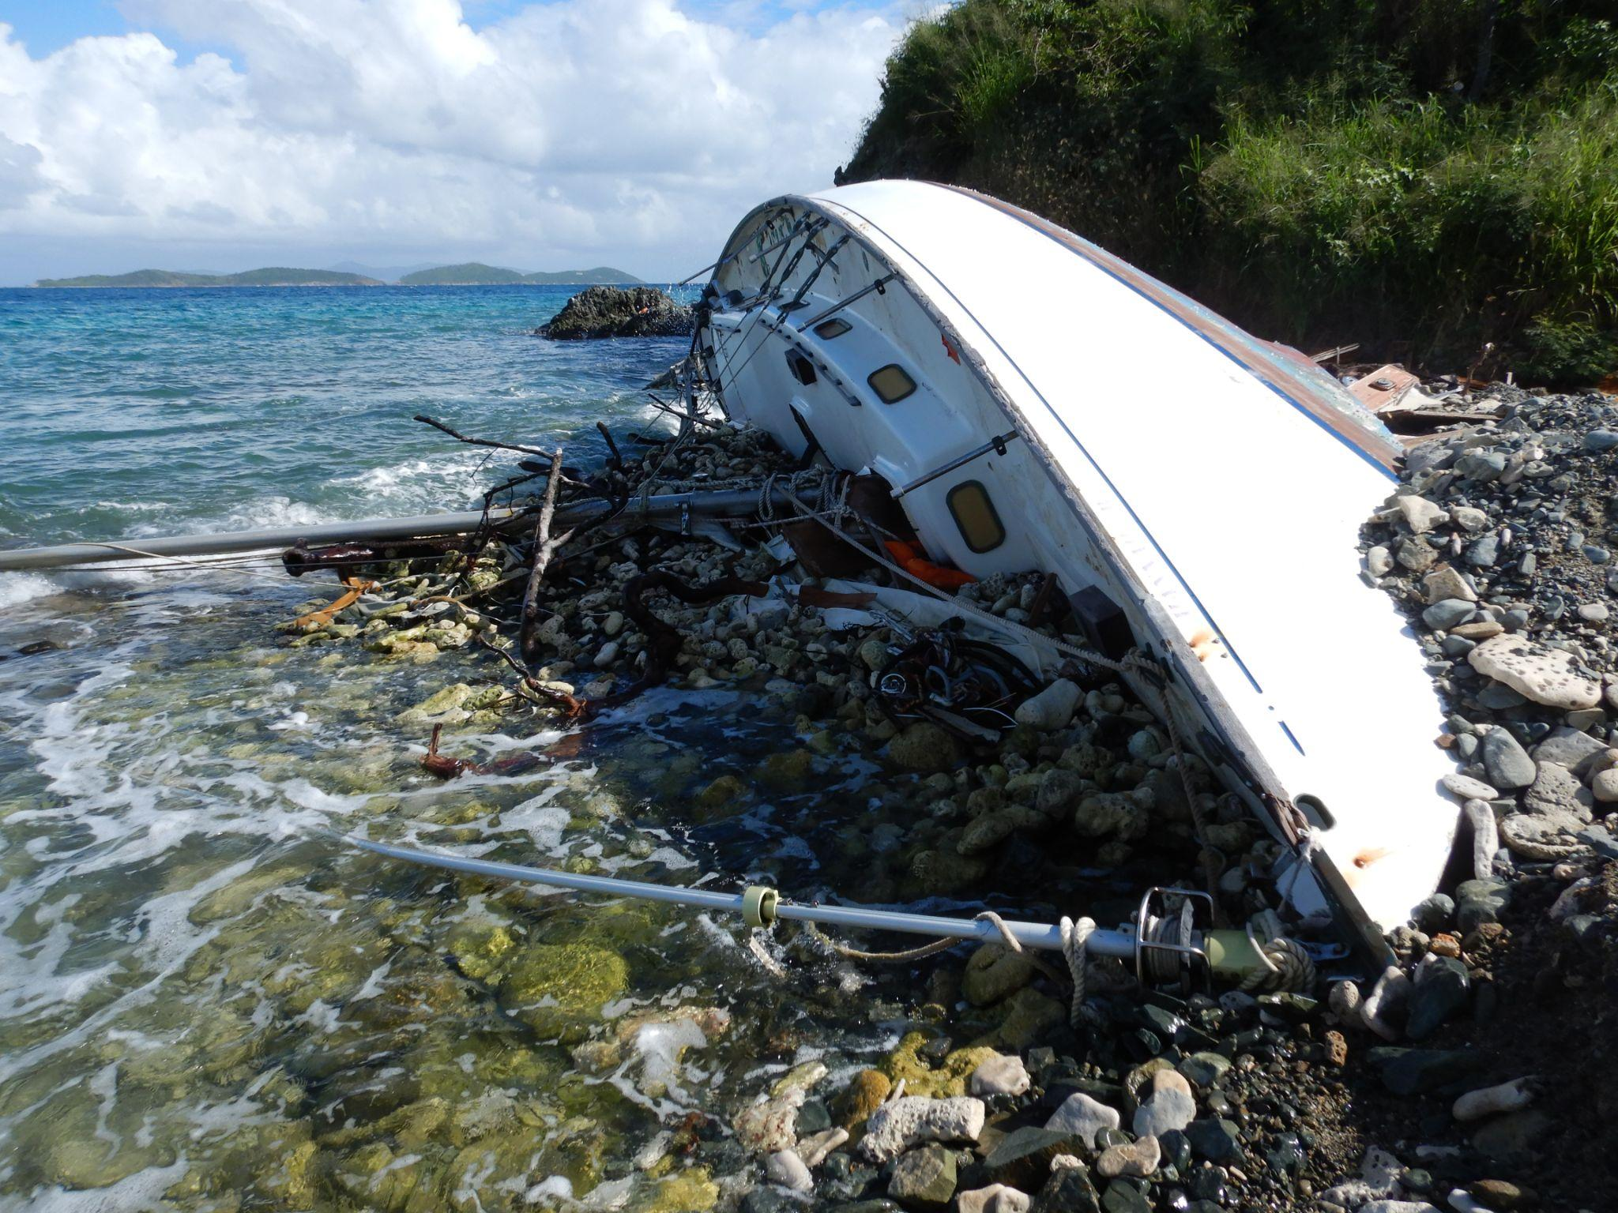
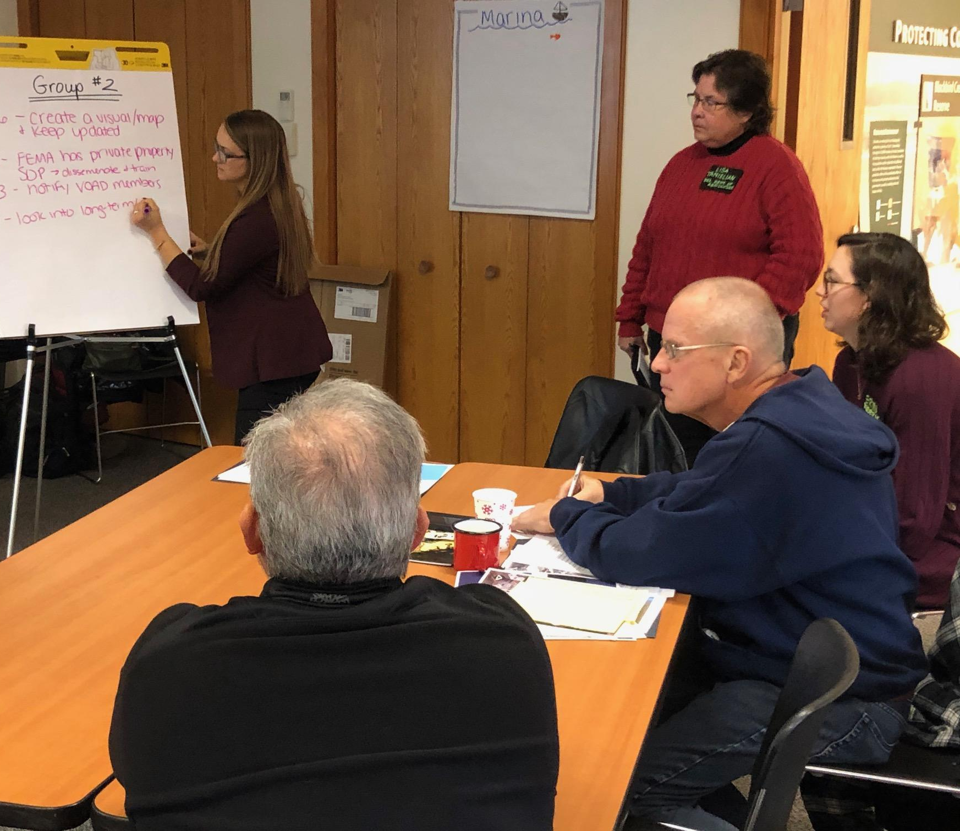
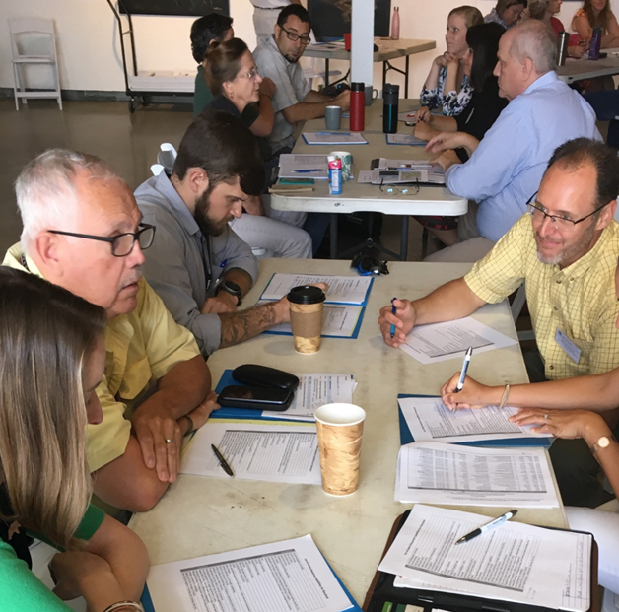
Putting Tools to Use
RESPONSE
INTEGRATION
COORDINATION
Marine debris after natural disasters
Linking to other plans and exercises
Building relationships
Notes:
Now I’ll step through a few examples of how the guides and the tools included in the guides have been or can be used by responders.
I’ll step through an example of how guides could be used and have been used during response to natural disasters, how they’ve been in integrated into existing plans, and how they can be used to build relationships.

Slide 22

2015 2016 2017 2018 2019 2020 2021 2022
Where Used
FEMA-led Joint Field Offices
State and U.S. Coast Guard led Incident Command Posts
Flowcharts for vessel removal
Environmental and historic preservation consultations
Hx Ida
How Used
Hx Fiona
Hx Sally
Hx Nicole
Hx Ida
Hx Laura
Hx Delta
Hx Zeta
Hx Ian
Notes:
For natural disasters, here is an image that displays only some of the hurricanes that have hit the Gulf of Mexico and southeast regions between 2020 and 2022.
We have gotten feedback from partners that are guides were used in FEMA lead joint field offices as well as state and Coast Guard lead incident command post.
The flow charts were used to aid and vessel removal and our permitting and compliance handouts were used to conduct historic preservation consultations.
We love receiving this type of feedback so that we know if our guides are useful, and how they can be better.

Slide 23
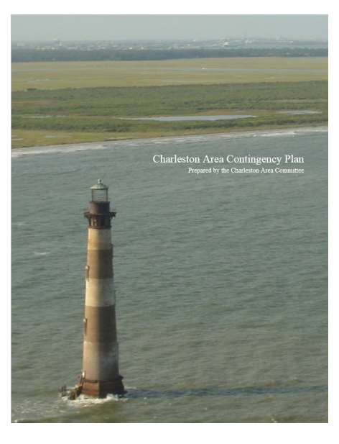
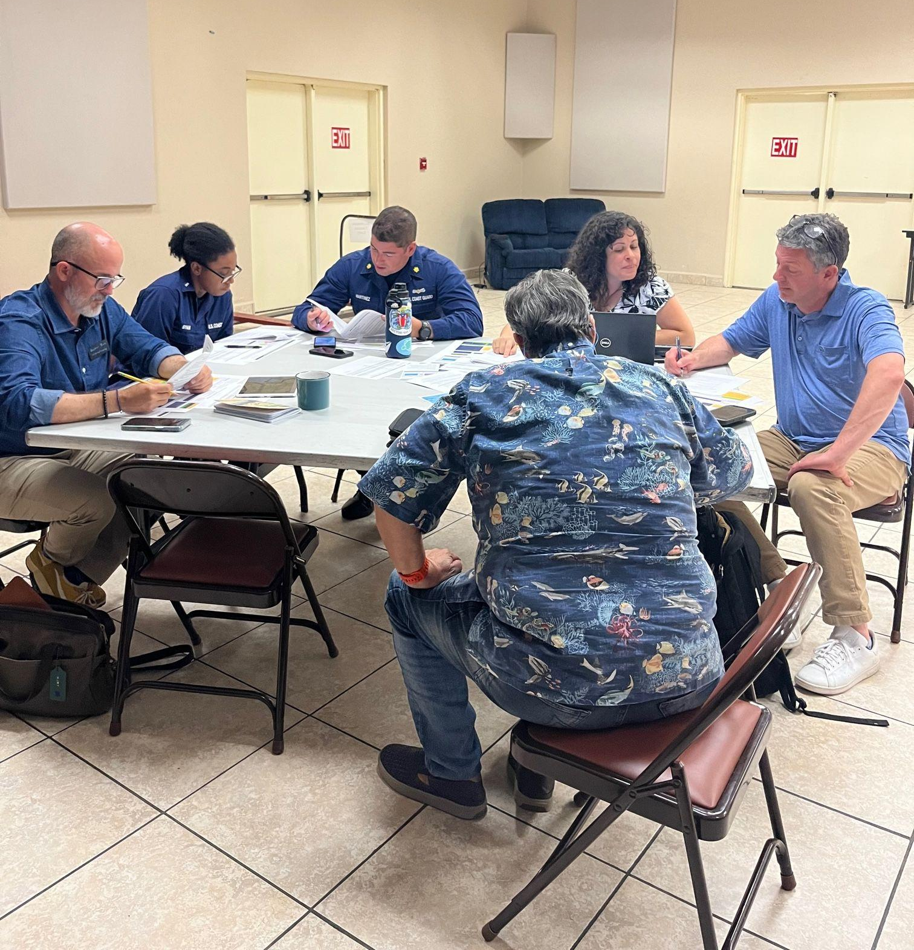
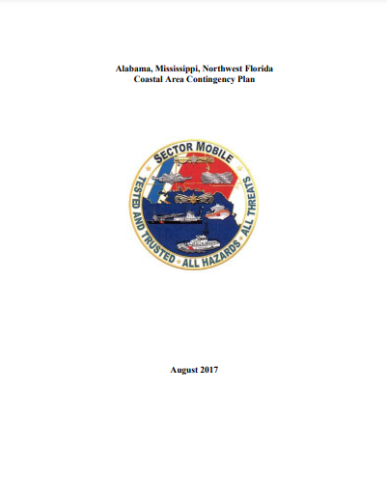
Integration in Other Plans and Exercises
Puerto Rico Tabletop Exercise May 2023
Notes:
Because these documents are written collaborative collaboratively with the state and other federal agencies, we support the use of this information in anyway that is most beneficial, which includes integrating it into existing plans, training, and exercises.
For example, several Coast Guard sectors have been including links to their respective states response guides in the appendix of their area contingency plans. Sector Charleston and sector mobile are two examples of this.
We also want to make sure that the information included is accurate and accessible to everyone. So we conduct regular exercises to show responders how the tools can be used and to raise awareness. The image here was from a recent tabletop exercise we conducted last year in Puerto Rico, and we just conducted another one two weeks ago at the Florida Governor's hurricane conference.

Slide 24
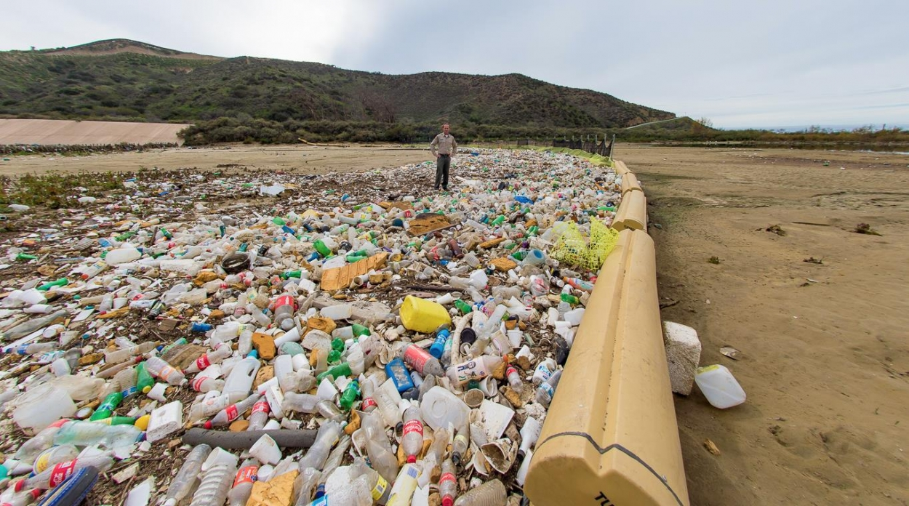
COORDINATION
Adaptation for binational use between U.S./Mexico within the Tijuana River NERR watershed
Notes:
Lastly, our guides can be used to help build relationships.
I wanted to share a quick success story from our partners at the Tijuana River national Estuarine research reserve. They have marine debris issues on either side of the Tijuana river, which is an issue shared by both the US and Mexico.. Our partners with the Tijuana River NERR used our United States Marine debris response guide as a template, to begin creating their own bi-national marine debris emergency response guide, which is being developed right now.

Slide 25
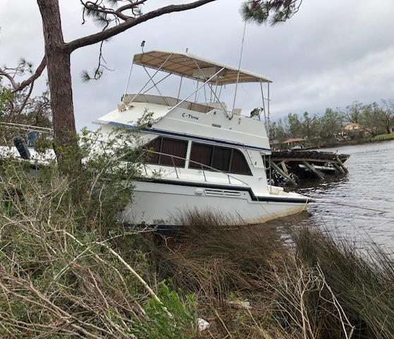
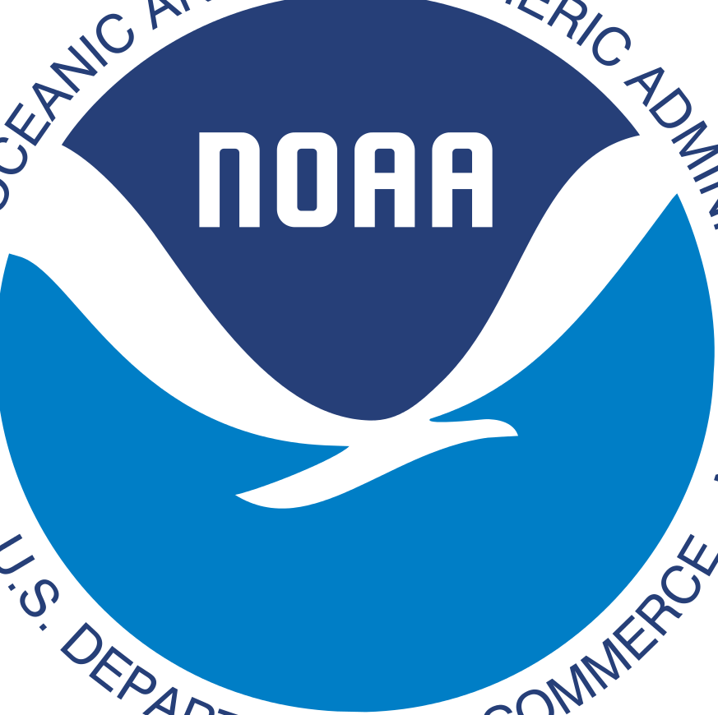
Applying Tools for Abandoned and Derelict Vessel (ADV) Response
Notes:
As you might imagine, a major concern after storms is abandoned and derelict vessels, so I want to spend a little bit of time discussing some of our tools and resources can be used to address ADVs.

Slide 26
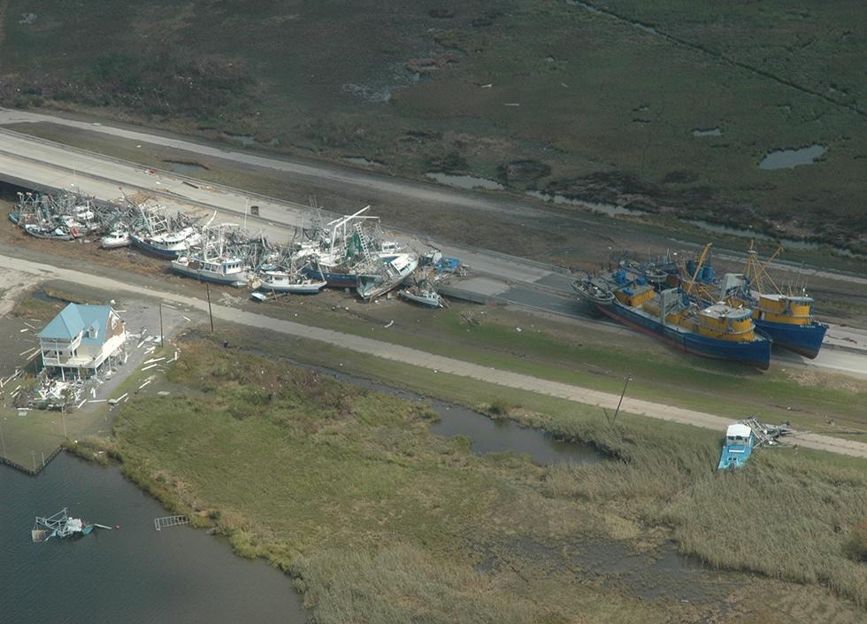
ADV Impacts
Obstruct navigation channels
Damage sensitive habitats
Release oil or hazmat
Illicit activities
Photo: NOAA
Photo: WCIV
Notes:
I’m sure everyone in this room is familiar with the issue of derelict vessels, but I’ll go through a few of the major impacts.
Potentially thousands of abandoned and derelict vessels litter waterways all over the country and threaten our ocean and coasts. They obstruct navigational channels and interfere with port operations, damage sensitive habitats, release oil or other hazardous materials, harbor illicit activities, and may diminish commercial and recreational activities.

Slide 27
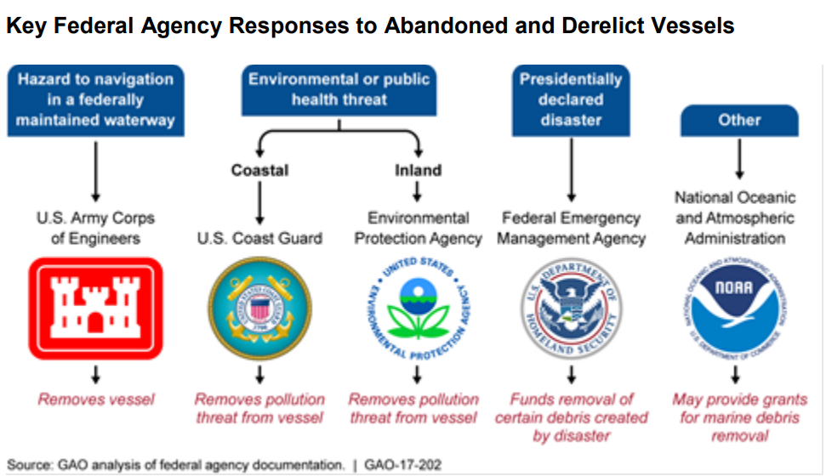
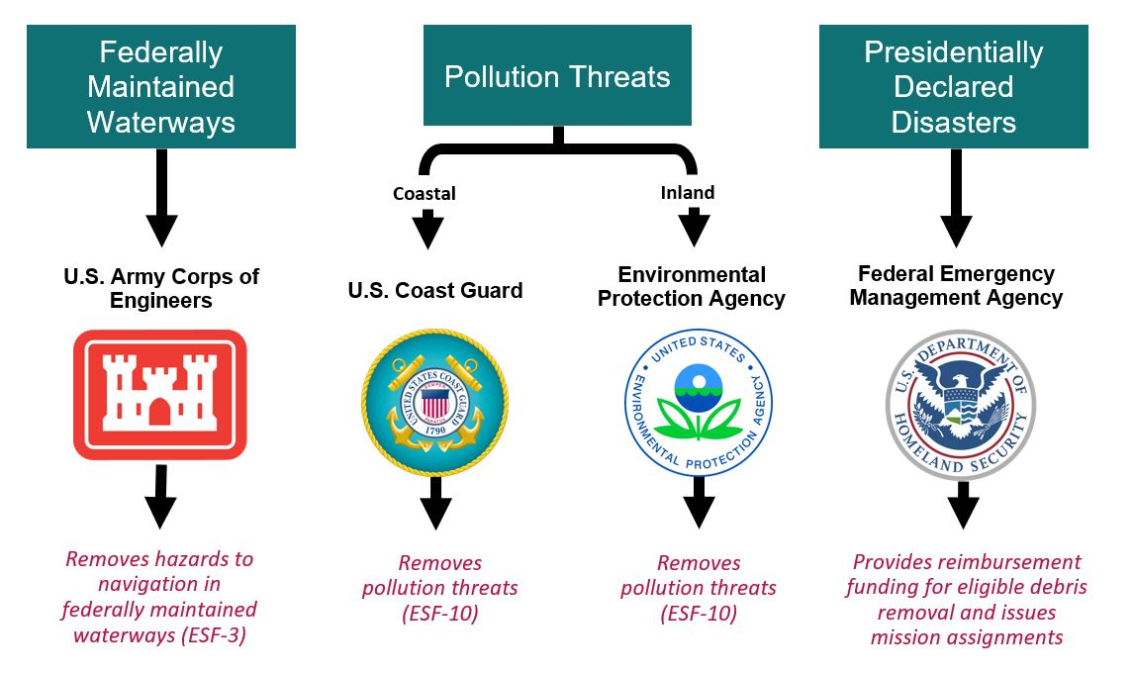
Federal
Government Challenges
Lack of funding
Lack of jurisdiction
Lack of authority
Lack of coordination
Lack of data
Source: GAO analysis | GAO-17-202
Notes:
Some vessels also impact federally managed waterways and lands, and managers struggle with similar challenges as state and local agencies- funding, jurisdiction and authority issues, lack of coordination, and lack of data.
The image to the right outlines the key responses to ADVs from each federal agency, which you can see here. \
Of these agencies, the US Army Corps of Engineers is the only federal agency that has the authority to remove vessels in federally maintained waterways, which are typically not where ADVs are found in coastal communities.
You all know what your roles are, but I will add that our agency, specifically our marine debris program provides competitive removal grants and occasionally supplemental funding after disasters that can include the removal of abandoned and derelict vessels

Slide 28
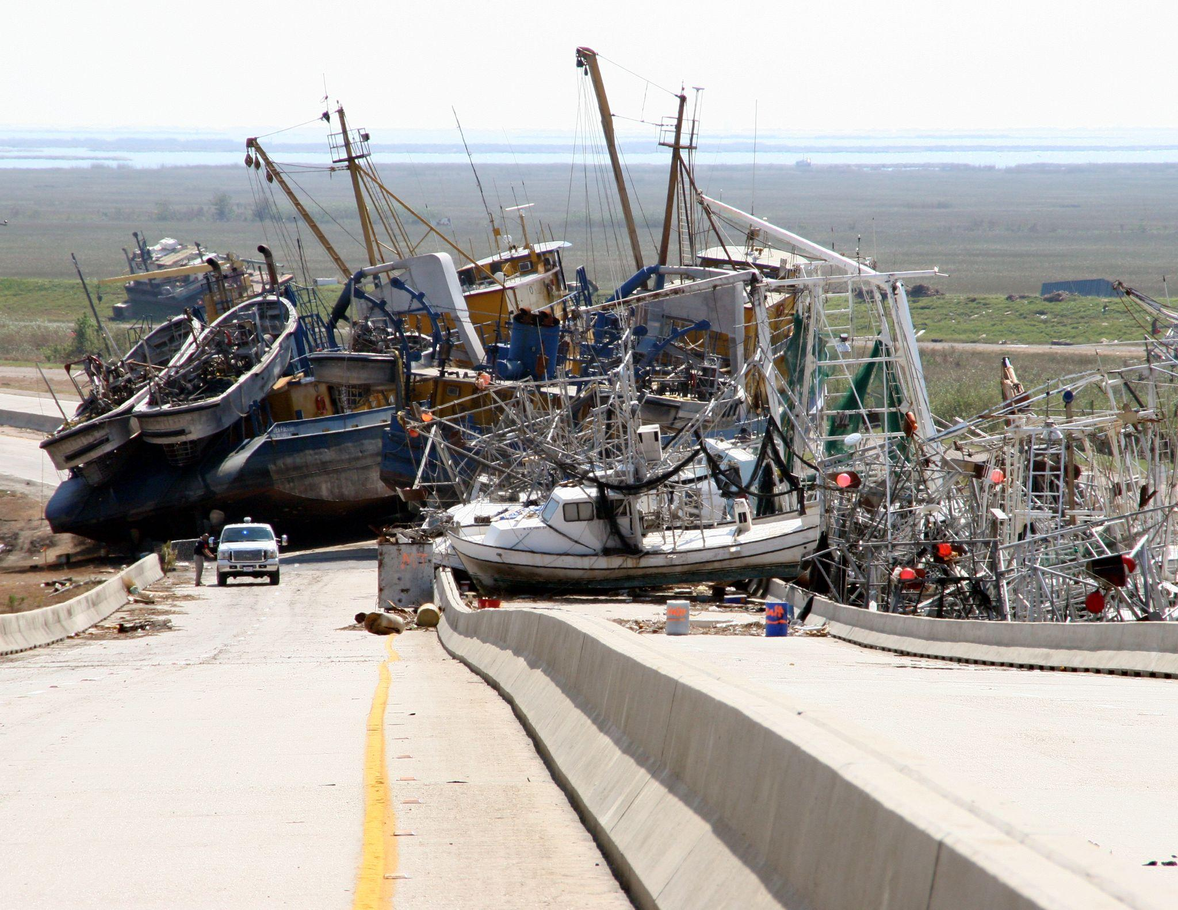
What’s Being Done?
Notes:
So what can we do about this?
Coordination is key. I’ll step through some of the resources we have and how they can help, but the main thing our program can do is help connect you with more people in the state or region that are working on this issue.

Slide 29
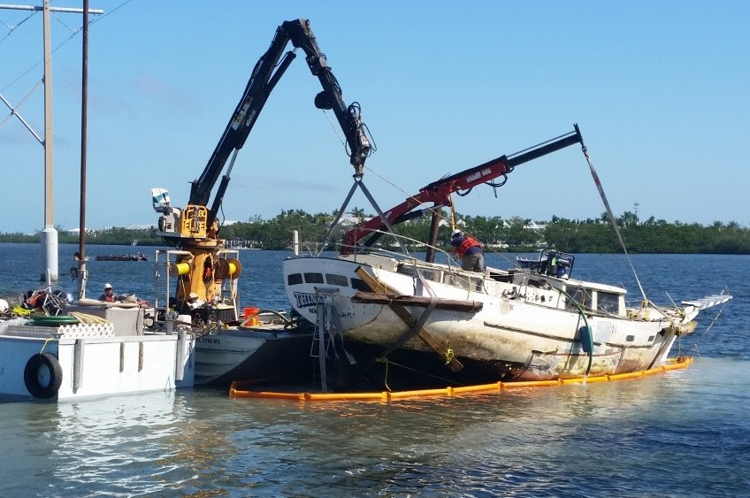
Funding
Marine Debris Removal
Supplemental
Bipartisan Infrastructure Law
Photo: Florida Keys National Marine Sanctuary
Photo: Florida Keys National Marine Sanctuary
Notes:
Lack of funding is by far the greatest challenge. Cost can vary significantly, often depending on the vessel size, habitat impacted, salvage techniques required, and disposal feasibility. To help with this, the Marine Debris Program has historically held an annual NOAA Marine Debris Removal funding opportunity. Funded projects focus on the removal of medium and large-scale marine debris, including ADVs.
Occasionally our program receives supplemental funding from Congress to support cleanup efforts in coastal communities impacted by disasters, but this is not guaranteed. From 2006-2020 the MDP has supported about 30 projects that have removed over 500 vessels.
While our removal and supplemental funding opportunities are not ideal for urgent cleanup needs, these grants can help address marine debris unable to be removed through response and recovery efforts. It is worth noting that the scale of the problem exceeds available federal funding.
Recently, through the Bipartisan Infrastructure Law, NOAA MDP received $150 million for marine debris assessment, prevention, mitigation, and removal over 5 years. Will likely be able to fund vessel removal whether response or chronic.
While we are not able to fund federal agencies, this might be where you can turn your partners to if they have questions or are looking for funding.

Slide 30
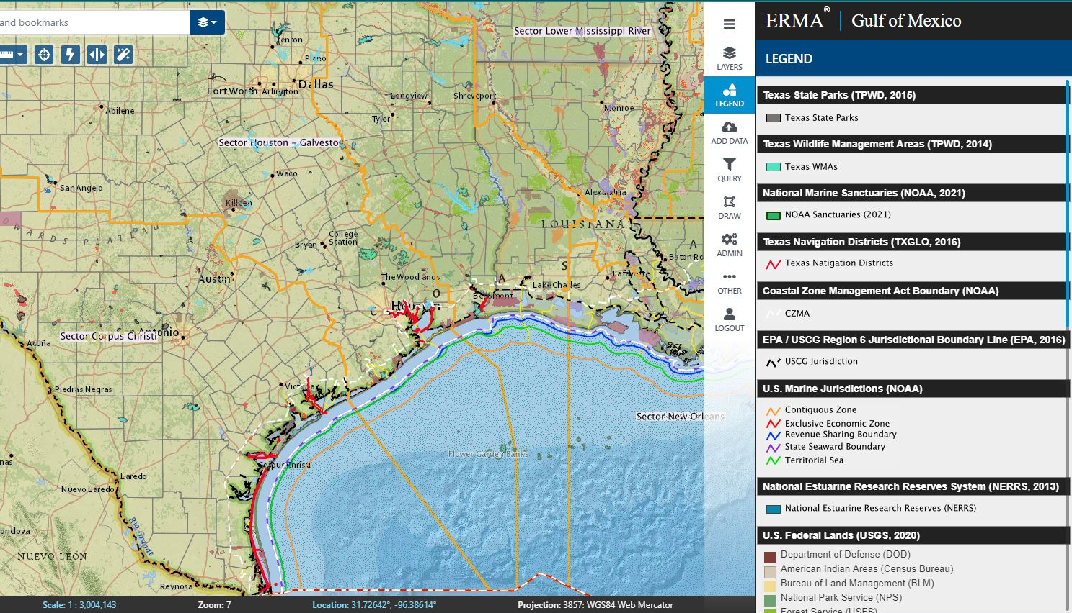
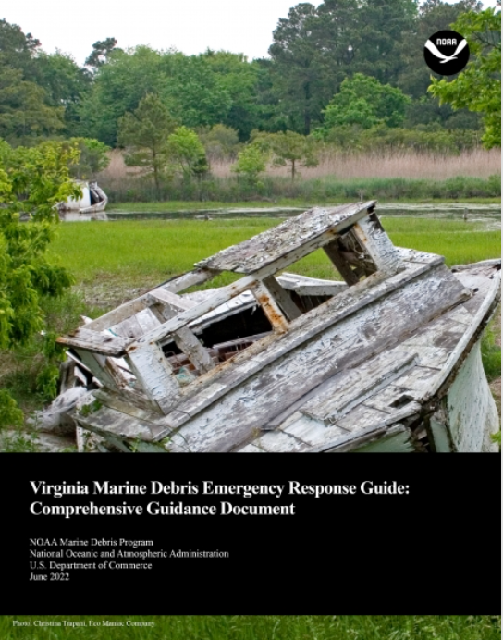
Marine Debris Response Guides
Roles and Responsibilities
Decision-tree Flowchart
Jurisdiction Map
Environmental Permitting and Compliance Support
Notes:
ADVs are often a large source of debris after storms and the Guides i discussed earlier outline the roles and responsibilities of responding agencies, provide permitting and compliance requirements, agency capabilities, and more.
The Guides also include a link to a dynamic map online that allows you to zoom in to an area of focus, to clarify agency boundaries and jurisdictions as well as information about environmental compliance and permitting

Slide 31
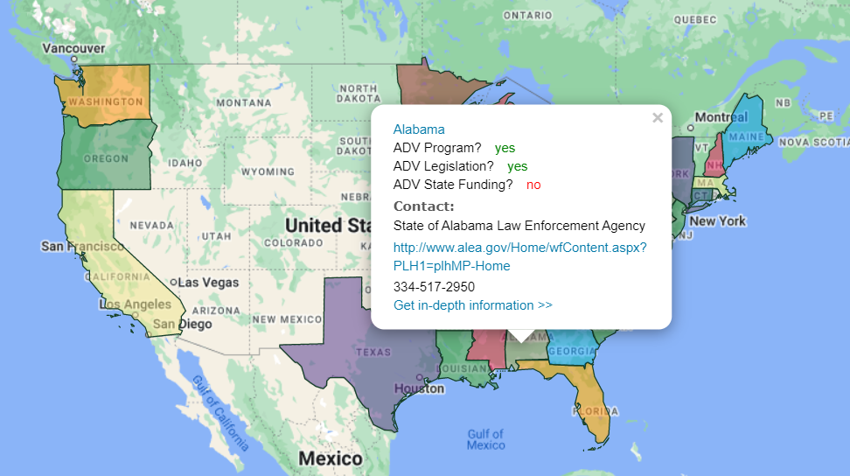
ADV Information Hub
ADV program information
Legislative overviews
Case studies
Resource links
Notes:
Another partner-suggested resource you can find on our website is our Abandoned and Derelict Vessel Information Hub.
The ADV Info Hub created a central source of information regarding programs and policies across the nation. On the site, you can see a quick view of each coastal state’s ADV information. Similar to what you see on your screen for Alabama. You can dig further to find more in-depth information on state legislation, case studies, or other resources.
During response its hard to figure out who has authority and what laws they have in that state so this can provide a useful starting point.

Slide 32
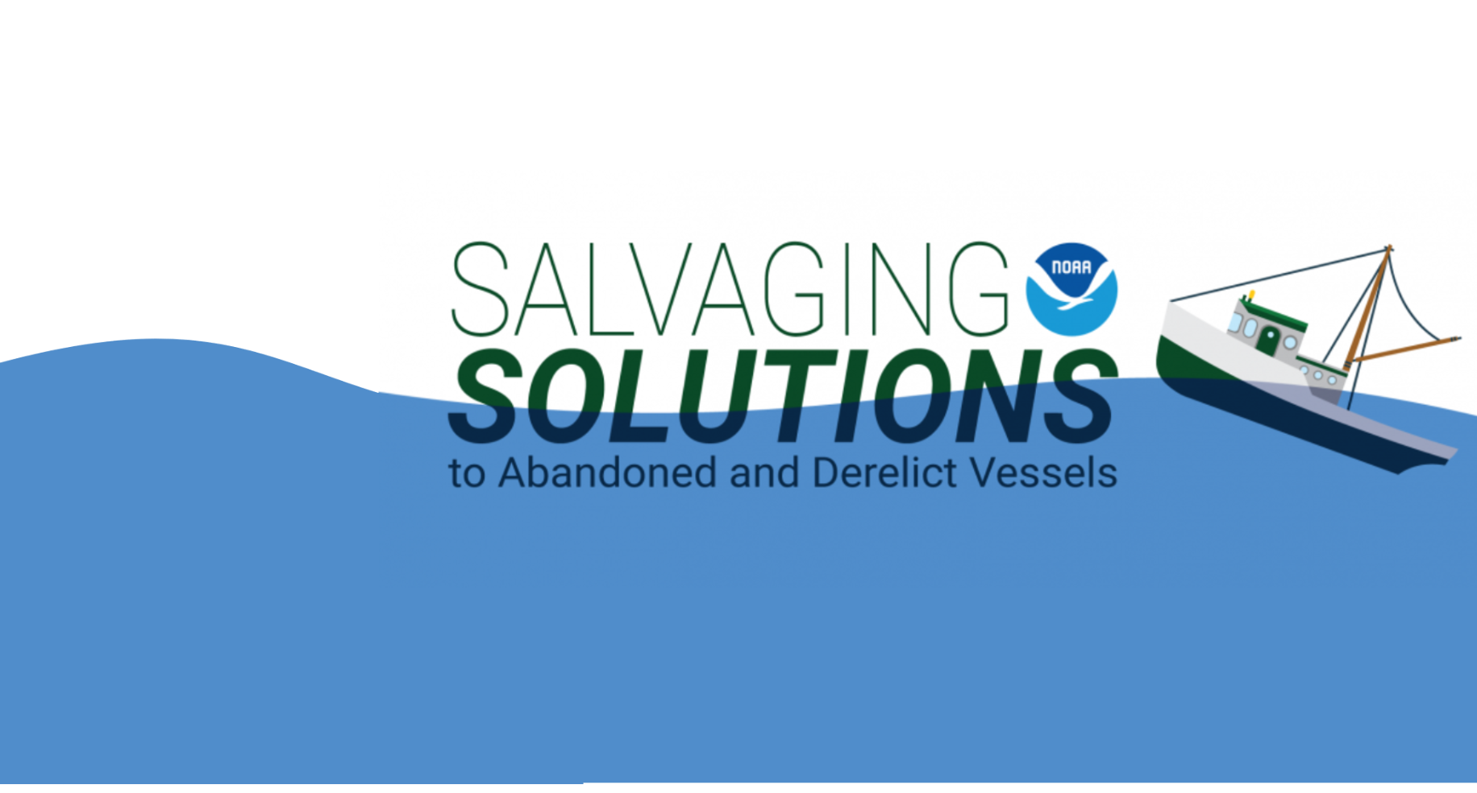
9 “episodes” on ADV topics
Improve coordination
30 experts shared expertise and experiences
1100 attendees across all webinars
Notes:
To improve coordination, we developed the Salvaging Solutions to Abandoned and Derelict Vessels webinar series. We hosted 9 “episodes” with ADV experts from across the country who shared their experiences, solutions, and lessons learned to help communities facing ADV issues.
These webinars were recorded so you or your local community partners can visit our website to learn more from the experts!

Slide 33
Resource Advisor (RA) Training
Habitat Protection during Removals
Notes:
After the busy 2017 hurricane season, local partners in Florida identified a need to deepen the bench of coastal managers trained to ensure that natural resources are protected when vessel or other large debris removals are taking place, whether after a disaster or during blue skies removal of chronic vessels. Several Resource Advisors Were trained to support USCG response effort in Florida but because of the large scale impact to the state only 2-3% of vessels that were removed were able to be overseen by RAs.
Because they play such an important role, FL said they need more RAs for future events.

Slide 34
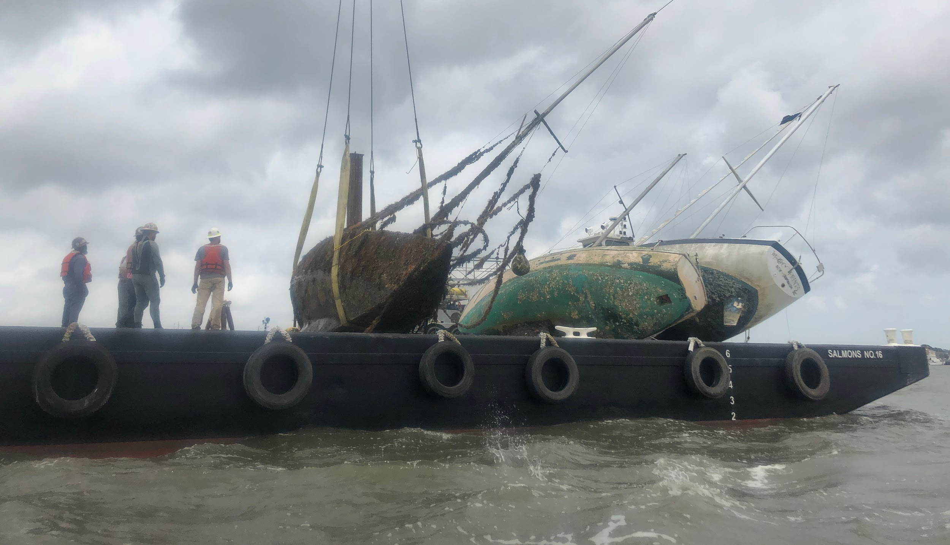
Two-day Virtual
RA Training
Improve coordination on removal operations
Protect natural resources from damage
Understand BMP and salvaging techniques
Notes:
In an effort to support this request, in 2020, NOAA and Florida Fish and Wildlife Conservation Commission developed the Resource Advisor training. During the training, real vessel removal case studies are used to educate participants about what to look out for in the field. Instructors walk through Best Management Practices and salvage techniques so newly trained Resource Advisors are prepared to support removal operations and provide suggestions to salvage companies.
In addition to supporting external partner organizations, this capacity-building is also important to NOAA’s operations. After disasters, NOAA staff may be deployed to assist with response and recovery efforts in the affected areas. These staff rely on local coastal managers, or Resource Advisors, to serve as their eyes and ears in the field to help NOAA ensure that coastal resources are protected during the response
We have trained over 200 Resource Advisors in the Gulf, Southeastern states, and Florida, and hope to be offering another virtual class for coastal managers in the future
Outside of response, some states use it to remove ADVs when there are chronic issues.

Slide 35
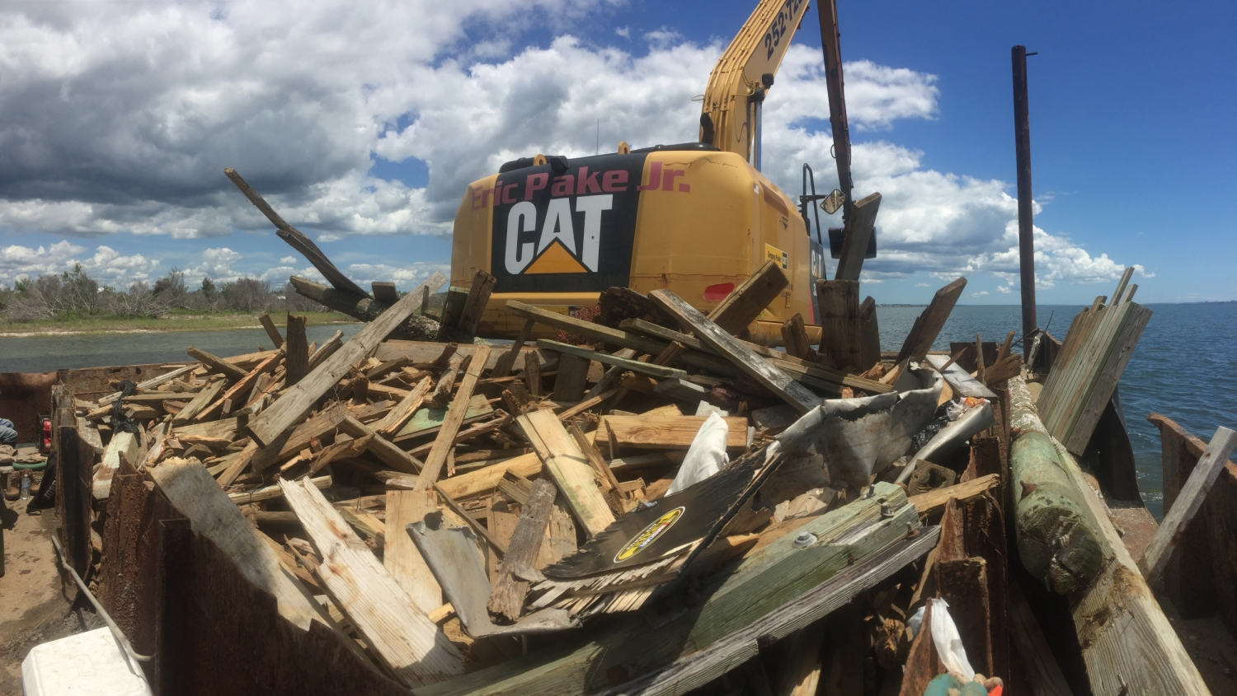
MDP RESPONSE & RECOVERY CAPABILITIES
Notes:
Everything I mentioned up until this point falls within that preparedness phase, but I do want to quickly touch on some of the capabilities at the marine debris program has during actual response and recovery.

Slide 36
Providing Support
COORDINATION
BMPS
MAPPING
Information sharing and coordination
Provide removal best management practices
Mapping and debris assessments
COMPLIANCE
DEPLOYMENT
FUNDING
Environmental permitting & compliance
Deploy to ICP, JFO, and/or EOC
Provide supplemental funding for recovery
Notes:
Like I’ve mentioned a few times now, where we can offer the most help is through coordination and information sharing, as well as offering resources to our partners, such as management practices for removal, mapping and debris assessments, and expertise on environmental compliance and permitting
Additionally, we do have trained staff ready to deploy to incident, command posts, joint field offices, and or emergency operation centers if requested. Our sister division, the emergency response division has scientific support coordinators that I know you are familiar with. These SSC‘s will often deploy for ESF 10 missions and sometimes they ask our program to come and assist with Marine debris response and removal. Since we are not a regulatory division, we need to be invited, but are always happy to have a seat at the table.
Finally, in the recovery phase, we will sometimes receive supplemental funding from Congress to allocate to our state partners to aid in their recovery and marine debris removal efforts. If you’re interested in learning more about our past supplemental funded projects, please reach out to me or check out our website.

Slide 37


THANK YOU!

